Slide 1
APAC AIC program
2023
‘Leading with influence’
WORKSHOP 4:
INFLUENCING WITHOUT
AUTHORITY
Campbell Macpherson
Change and Strategy International

Slide 2
Your Program
Kick-off Session
HBDI and Program Overview
Workshop 1
Emotionally Intelligent Leadership
Putting EQ into practice
Workshop 2
Communication that Works
Communicating technical material, w/out diminishing expertise
Workshop 3
Leading and Embracing Change
Incl. Stakeholder Engagement
Workshop 4
Influencing without Authority
Incl. Managing Upwards & across continents
Peer Mentor
Session
90 min session for each delegate
Group
Session
90 min group mentoring session

Slide 3
Today
9:30 - 9:45 About Authority | Introduction What is ‘Authority’? Influencing without authority – challenges and what good looks like
9:45 – 11:00 Persuasion | Secrets from the Science of Persuasion How will you use each one with your key stakeholders?
11:00 – 11:15 | Break
11:15 – 12:45 Leading without Authority | Leading without authority Top Tips from ‘Leading without Authority’ Discussion and application Managing Upwards Influencing other parts of TRP
12:45 – 13:00 | Close Summary and light bulb moments Group Mentoring Session

Slide 4
Types of authority
Formal Authority:
Hierarchical
Traditional
Legal / Rational
Personal Authority:
Integrity / Morality
Coercive / Persuasive
Expertise / Credibility
Trustworthiness
Is this influence?
Or is it compliance?
This is influence
“Position does not define power – impact defines power. Impact can be made in every role at every level - and when we prioritize bringing out the best in those around us, business growth and success follow.”
Mindy Grossman CEO WW International

Slide 5
What is influencing without authority …
Influencing without authority is the ability to influence others
without having any hierarchical power over them.
You don’t have to be the CEO or even the most senior person in the room to have influence. Skills such as deep listening, effective assertion, and self-awareness are all tools you can use - and develop - to influence people around you no matter what the hierarchy.
Influencing without authority is a critical skill for any leader.
Whether you are a team leader, the manager of a cross-functional team, leading a new initiative, or overseeing projects and resources, the ability to influence without authority can help you get engagement from key stakeholders, improve collaboration and results, and boost your career.

Slide 6
Influencing without Authority
Challenges
Describe good influencing without authority

Slide 7
Secrets from the Science of Persuasion

Slide 8
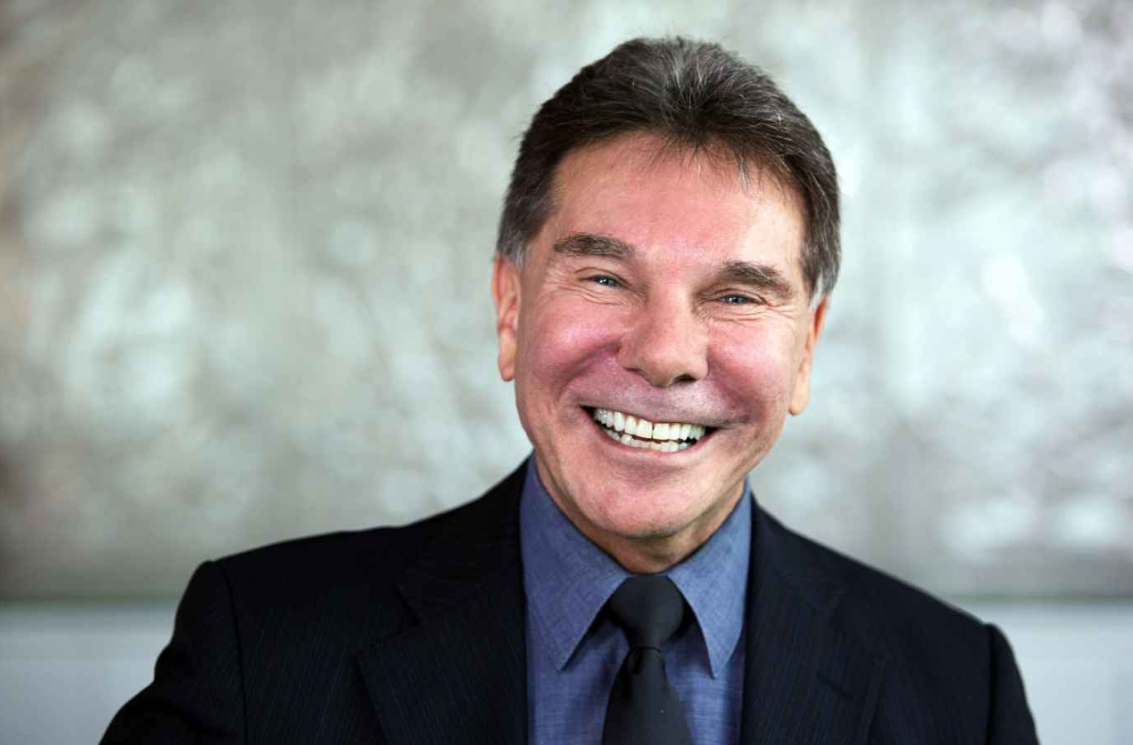
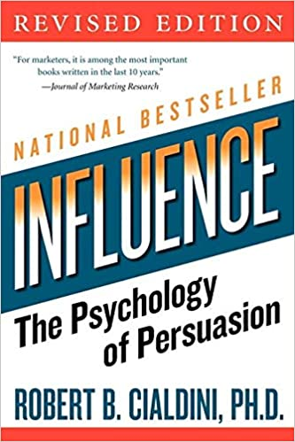
Influence: the psychology of persuasion
Robert Cialdini, is the author of the New York Times, Wall Street Journal and Business Week International bestselling book ‘Influence: the psychology of persuasion.
It explains the psychology of why people say yes and how to apply these principles ethically in business and everyday situations.

Slide 9
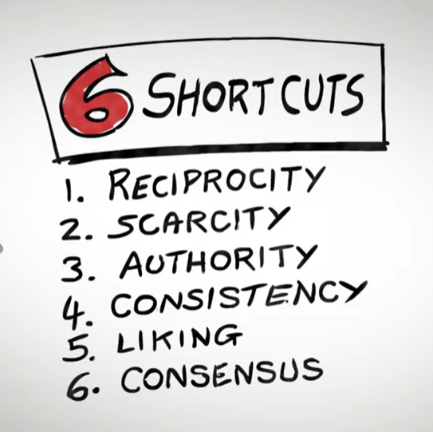
Influence: the psychology of persuasion

Slide 10
Handout: How will you influence your key stakeholders?
Stakeholder | Reciprocity | Scarcity | Authority | Consistency | Liking | Consensus / Social Proof
Notes:
Handout

Slide 11
Handout: Summary Sheet
Reciprocity
Key points
People are obliged to give back to others the form of behaviour that they have received.
Those that give first benefit the most in the long-term.
It's important to move from a space of 'who can help me?' to 'who can I help first?'
Scarcity
Key points
People are more motivated by loss than gain in exactly the same situation.
Leaders can use both 'loss' and 'gain' tactics to influence and persuade people.
Authority
Key points
Don’t speak too soon – ask people for their views.
Admit small mistakes before making their case on a particular matter has a powerful effect of gaining people's attention.
There is strength in small weaknesses.
Consistency
Key points
Leaders that want to spark consistency in their team should encourage their people to make small, voluntary, public commitments so that they follow through.
Liking
Key points
People prefer to say yes to people they like.
What do you like about the person you are interacting with?
We like people who: share similarities with us that are uncommon, pay us compliments, make cooperative efforts.
Consensus
Key points
Seeking the approval of others is a basic human need.
Behaviour can be influenced by pointing out desirable behaviour of others you want others to adopt.

Slide 12
Influence: the psychology of persuasion

Slide 13
Influence: the psychology of persuasion
Caldiani has since defined a seventh ‘shortcut’ …
Unity
Being valued as part of a team or group

Slide 14
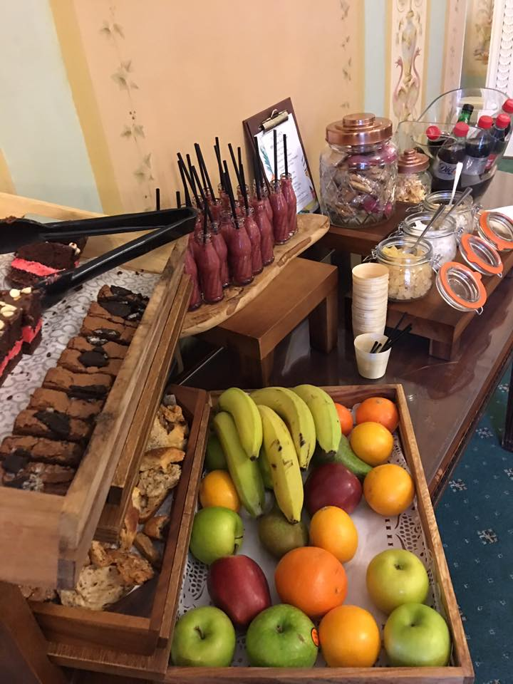
Break

Slide 15
Leading without authority

Slide 16
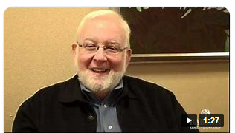
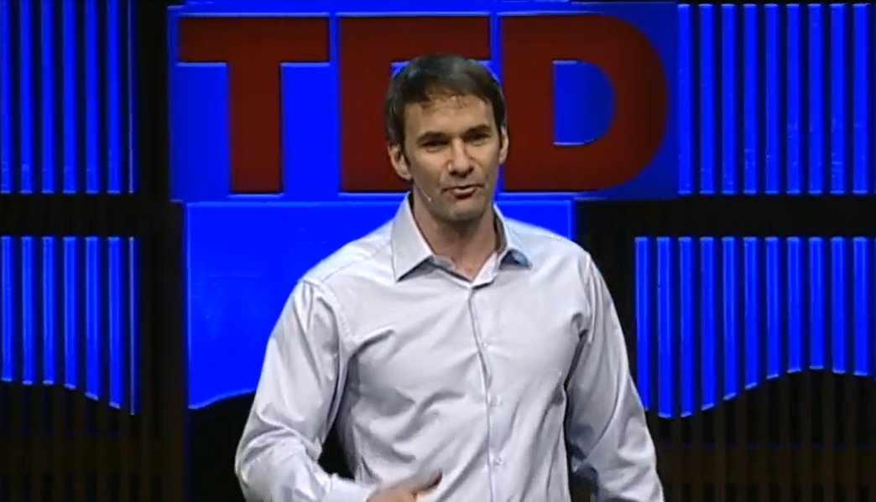
“You can’t achieve your objectives without getting help from others who you do not control.”
Allan R Cohen – Author, ‘Influence without Authority’
“You do not have to control more.
You have to influence more.
You have to co-create more.”
Keith Ferazzi – Author, ‘Leading without Authority’

Slide 17
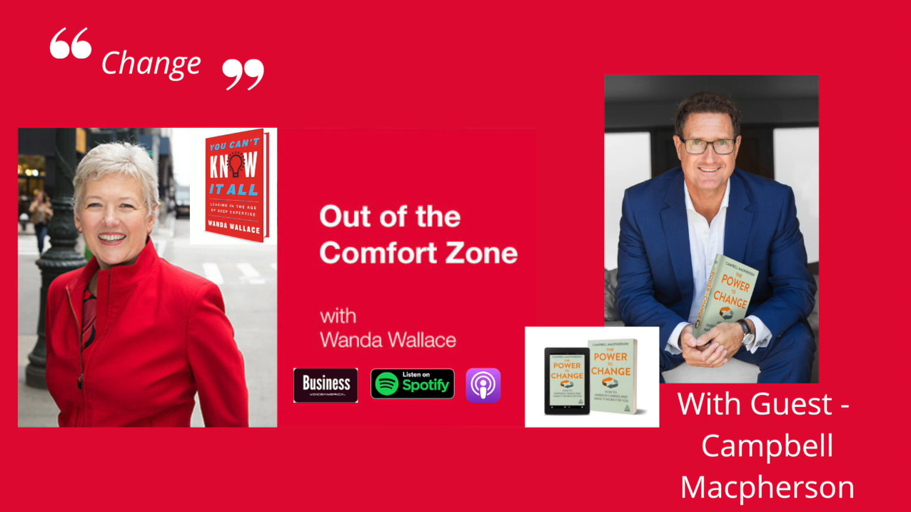
The best part of the blue book is the opening paragraph
“Influence is one of the hottest topics with all my clients.
So much work today is cross team, cross function, project-oriented where the person accountable rarely has formal authority.
If you do, and you use your formal authority, it doesn’t tend to go well.”
Wanda Wallace, President & CEO, Leadership Forum
VoiceAmerica Talk Radio, Host of ‘Out of the Comfort Zone’

Slide 18
Top Tips from ‘Leading without Authority’
‘Co-elevation’: Going Higher Together
“Accept that it is all on you.” Define the outcomes you need to achieve – and own them.
Define who is on your team
Earn the permission to lead. Don’t ask for it; earn it.
Take charge of your key relationships
Create shared objectives and co-develop solutions
Be a leader:
Help others to succeed
Praise and celebrate
Share the acclaim and the blame

Slide 19
1. Accepting that it is all on you
Accepting accountability for an outcome without being granted authority is tough.
But what is the alternative …
Put up with it and keep your head down?
‘Stay in your lane’?
Not deliver your best?
Don’t live up to your potential?
Notes:
Discussion of the challenges and pitfalls of Accepting that it is all on you. Ask for examples.

Slide 20
1. Accepting that it is all on you
“Avoiding the six deadly excuses” (for not influencing without authority):
Ignorance – of why and how to influence
Too busy / Too hard
Deference
Victimhood
Fear
Pride
And one the author doesn’t mention:
It just feels inappropriate – as though I am stepping on people’s toes
Notes:
Give examples of each as required, ask for examples and discuss. Bring delegates back to “what is the alternative?”

Slide 21
2. Define who is on ‘your team’ – and build relationships
“The future of leadership requires a focus on identifying the right teammates for each project.”
“Your team is made up of everyone who is critical to help you achieve your objective.”
Select your key stakeholders. The person/people you need for the success of the project
Build relationships before you need them
Prioritise
Face the person or problem you have been avoiding
Be systematic about building these relationships
Notes:
Discuss the challenges of this. Revisit your Stakeholder Assessment from Module 3. Ask yourself A-F. Discuss in pairs.

Slide 22
A related aside: Creating high performance (virtual) teams
Which of these did Google find to be the top indicator for high performing teams?
Team members are high performing individuals
Team size
Psychological safety
Tenure
Team members feel their work has impact
Dependability of members
Co-location of teammates
Structure & clarity of roles
Team members have seniority and experience
The work is personally important to team members
Workload size
Extroversion of team members
Notes:
We all have to have difficult conversations – and often we go to any length to avoid them

Slide 23
Google’s high-performing teams
Psychological Safety
Dependability
Structure & Clarity
Meaning
Impact

Slide 24
Google’s high-performing teams
+17%*
Safe team
-19%*
Unsafe team
* Target sales revenue

Slide 25
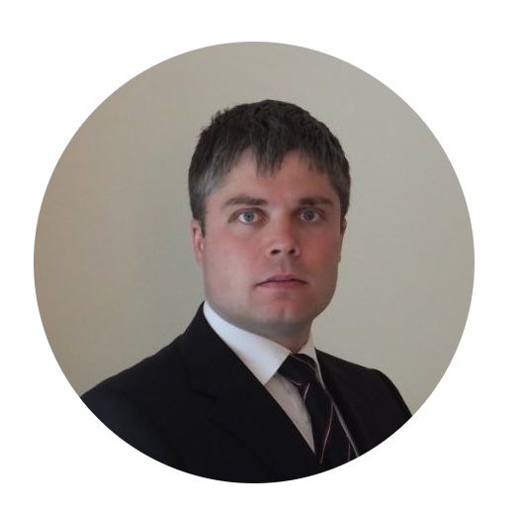
3. Earn the permission to lead
Don’t ask for it. Earn it. Be proactive.
Frustrated by the ineffectiveness of the Sales structure yet in a role with no direct reports and little hierarchical authority
Constructed a presentation explaining the problem and potential solutions
Presented it to his boss and Senior Management
Was appointed Executive Sponsor of the critical Sales Operations workstream of the new global Go To Market Strategy initiative
Adam Corden
Head of EMEA Sales Capabilities
T. Rowe Price
Notes:
Discuss Adam. Ask yourself how you could be more proactive

Slide 26
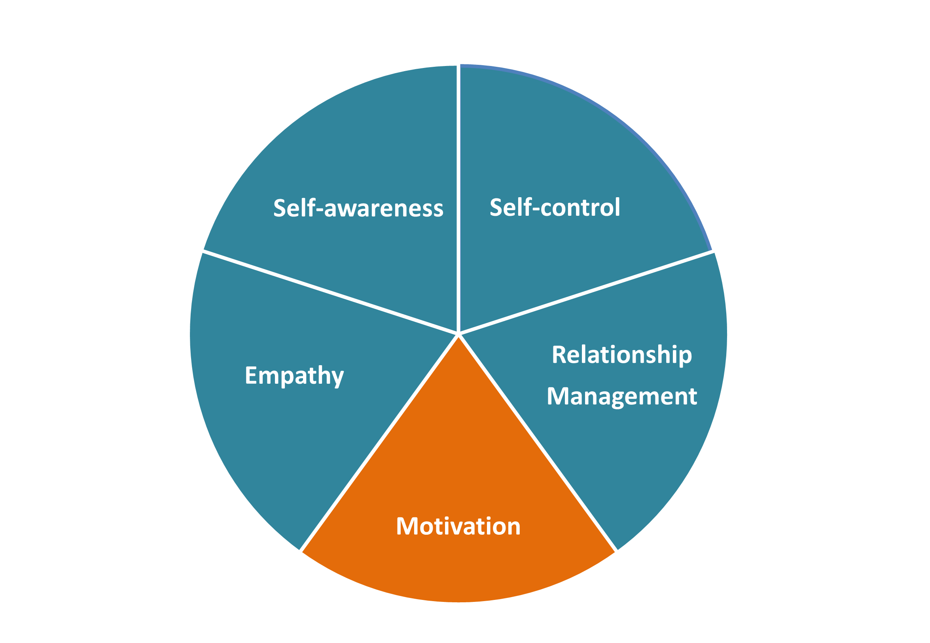
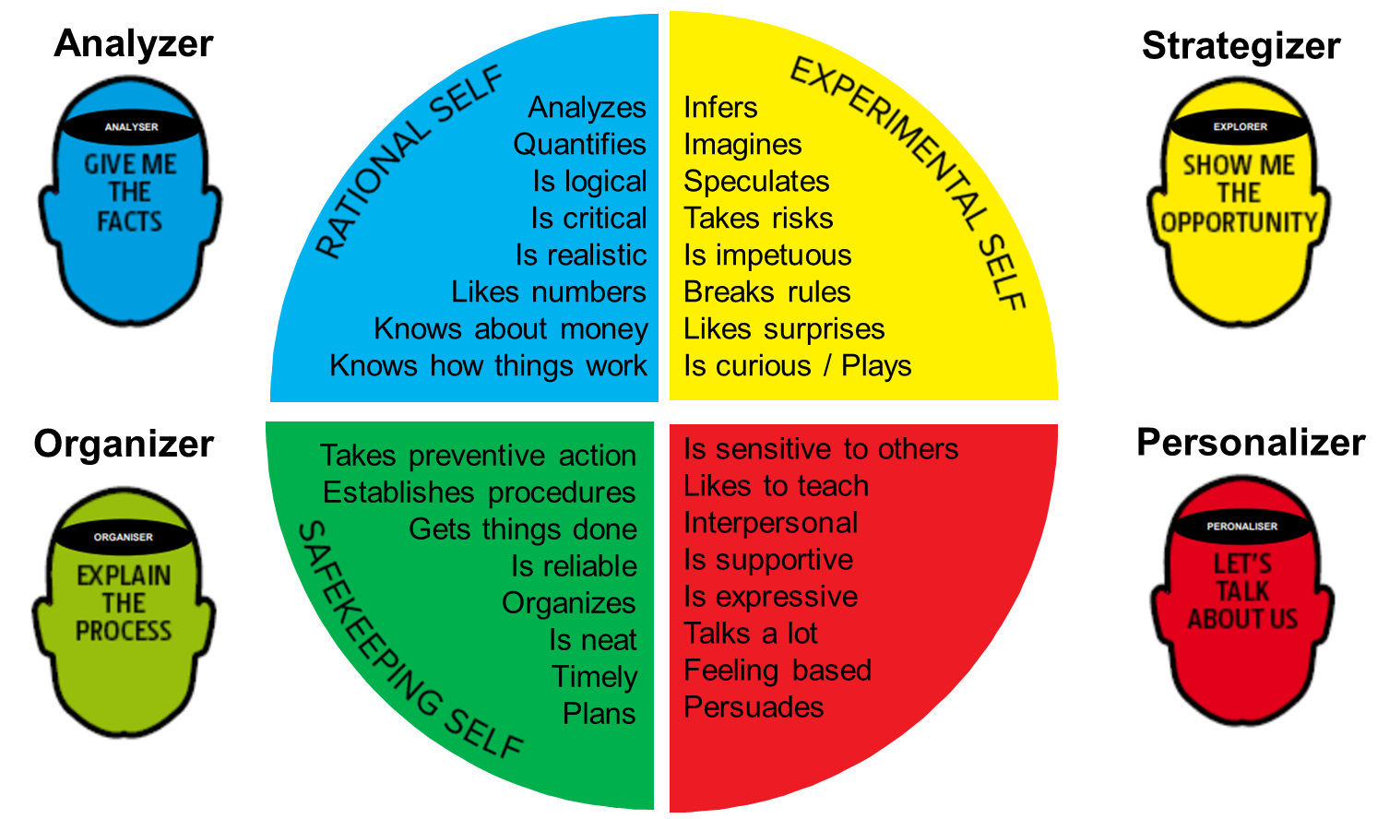
4. Take charge of your key relationships
Notes:
Discuss in detail – use examples – run a 5x5x5 exercise?

Slide 27
4. Take charge of your key relationships
How?
Take the initiative. (“You go first.”)
Confront superficial ‘nodding head’ collaboration. Encourage listening to understand
Create deeper, richer, more collaborative partnerships.
Encourage collaborative solutions to problems and opportunities
Exercise: 5x5x5 (5 mins explaining a problem. 5 mins understanding. 5 mins potential actions.)
Adopting a new definition of ‘collaboration’.
Collaboration is not a last resort when you can’t do the job on your own.
It is genuine partnership with colleagues to deliver innovative solutions, real breakthroughs and superior results – for everybody.
Notes:
Discuss in detail – use examples – run a 5x5x5 exercise?

Slide 28
Managing difficult conversations when emotions run high
Be brave.
Engage!
Create a safe atmosphere where people can express what they feel without fear
Find areas of agreement – shared objectives / purpose
Objectivity - let the facts lead
But be aware of the emotions in play – constant scanning
Control your emotions / how you react
Listen: “Being curious stops them being furious”
Check understanding - what you say may not be what they hear and vice versa
Believe that they have the best of intentions and convince them that you do too
Notes:
There is a brilliant book called Crucial Conversations that covers in detail how to handle difficult conversations. I have summarised it here.

Slide 29
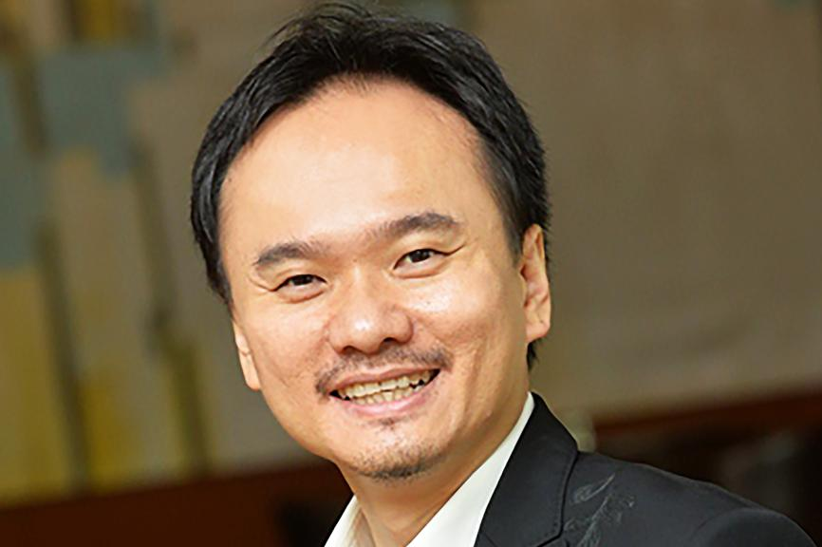
All constructive interactions are based on …
“100% respect.
Zero fear.”
David Chiem: CEO of MindChamps
Asia’s Most Influential Entrepreneur 2022
Notes:
Talk about David. Discuss how this could change their department if their leaders were to create this sort of culture. How could they start to use this approach?

Slide 30
Breakout: influencing and managing upwards
What is your view of ‘managing upwards’?
Challenges?
How to do it effectively?

Slide 31
Tips for Managing Upwards
Don’t sit on bad news
Tell them how to get the best out of you
Demonstrate your expertise
Display the qualities your managers love
Learn from them
Suggest solutions to problems (kindly)
Understand their motivation
What does your boss need / want?
Why?
What is the best way to help them?
“100% respect. Zero fear.”

Slide 32
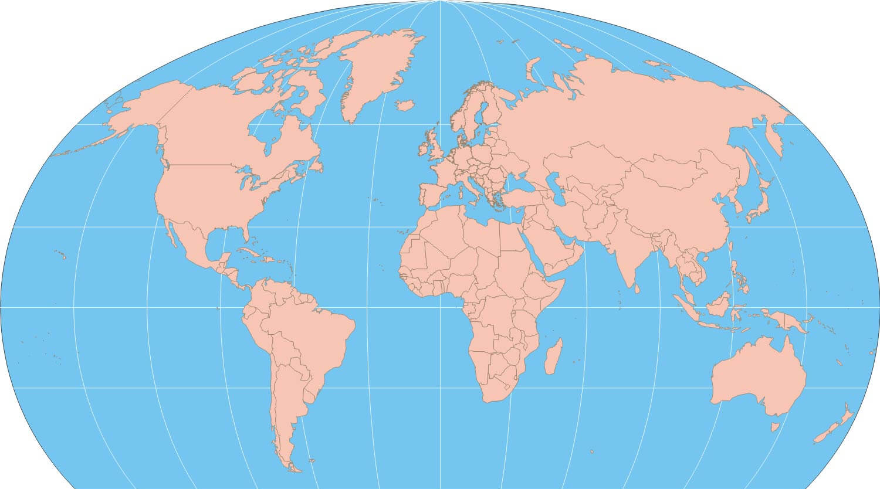
Discussion: influencing other parts of TRP
Your key stakeholder groups:
Across APAC
In EMEA
In USA
…
Challenges and solutions?

Slide 33
Influencing other parts of T Rowe Price
Find areas of agreement – shared objectives / purpose
Clarify your aspirations and motivations (what you want to achieve and why / what drives you)
Understand their aspirations and motivations
Understand their communication preferences and barriers to change
Understand yours – and how you need to adapt
Be solution-oriented
Be proactive
“100% respect. Zero fear.”

Slide 34
Where are we in today’s agenda?

Slide 35
Top Tips from ‘Leading without Authority’
‘Co-elevation’: Going Higher Together
“Accept that it is all on you.” Define the outcomes you need to achieve – and own them.
Define who is on your team
Earn the permission to lead. Don’t ask for it; earn it.
Take charge of your key relationships
Create shared objectives and co-develop solutions
Be a leader:
Help others to succeed
Praise and celebrate
Share the acclaim and the blame

Slide 36
5. Create shared objectives and co-develop solutions
Notes:
A great diagram / model to use with potential co-creators

Slide 37
6. Be a leader
Help others to succeed
Praise and celebrate
Share the acclaim and the blame

Slide 38
Top Tips from ‘Leading without Authority’
‘Co-elevation’: Going Higher Together
“Accept that it is all on you.” Define the outcomes you need to achieve – and own them.
Define who is on your team
Earn the permission to lead. Don’t ask for it; earn it.
Take charge of your key relationships
Create shared objectives and co-develop solutions
Be a leader:
Help others to succeed
Praise and celebrate
Share the acclaim and the blame

Slide 39
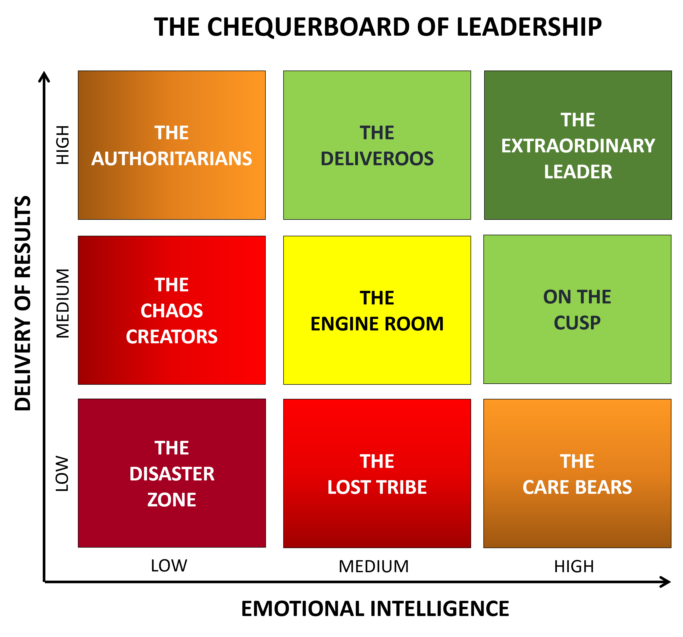
Which is ‘emotionally intelligent leadership’ – as we know
The Chequerboard of Leadership
The 5 Elements of EQ

Slide 40
Summary and Close

Slide 42
Preparation for the Group Mentoring Session
1
Reflections from the workshops:
Emotionally Intelligent Leadership
Communication that works
Leading & Influencing Change
Influencing without Authority
So what will you:
Stop doing?
Start doing?
Continue doing?
2
Your key objective:
Select one of your key objectives
Clarify the outcome you desire and the key challenges
Who are your key stakeholders and how will you influence them?

Slide 43
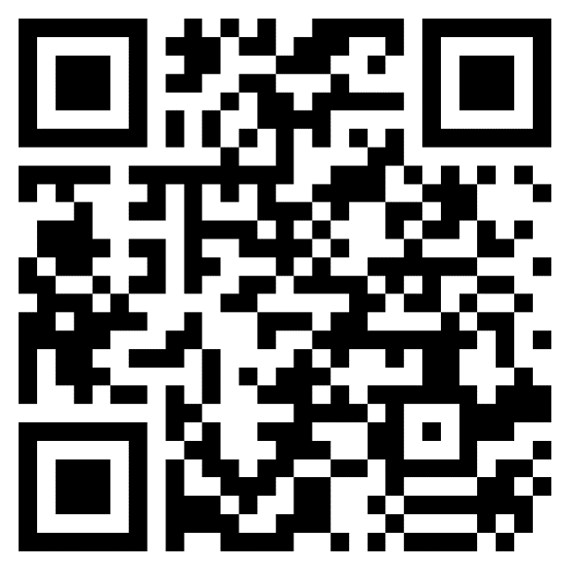
TRP HR asking for feedback after each workshop
Course Evaluation
Please access course evaluation through the URL or QR Code.
Link https://forms.office.com/r/m5mLDcfkmk

Slide 44
e: campbell@changeandstrategy.com

