Slide 1
APAC AIC program
2023
‘Leading with influence’
WORKSHOP 3:
LEADING &
EMBRACING CHANGE
Campbell Macpherson
Change and Strategy International

Slide 2
Your Program
Kick-off Session
HBDI and Program Overview
Workshop 1
Emotionally Intelligent Leadership
Putting EQ into practice
Workshop 2
Communication that Works
Communicating technical material, w/out diminishing expertise
Workshop 3
Leading and Embracing Change
Incl. Stakeholder Engagement
Workshop 4
Influencing without Authority
Incl. Managing Upwards & across continents
Peer Mentor
Session
90 min session for each delegate
Group
Session
90 min group mentoring session

Slide 3
Today
1 hour 30 mins Leading Change | Leading & Influencing Successful Change What have you learnt about change these last few years? Receiving Change 5 key truths about change Why the majority of change fails The essential ingredients of successful change Discussion
15 mins | Break
1 hour 30 mins Embracing Change | How we react to change The Change Matrix and the Change Curves The Change Curve Exercise Overcoming our personal barriers to change The SCARF Model Acceptance – inc group session Building resilience
15 mins | Close Light bulb moments and Stop/Strat/Continue Homework and intro to next module

Slide 4
Use your handbook to capture your ‘light bulb moments’
Notes:
In any meeting or workshop, if you can walk away with just one ‘light bulb moment’ it has been worthwhile. We are hoping you will have dozens of such moments throughout this program. Use your program notebooks to jot down ideas as they come to you during the workshop – pieces of insight, ideas, actions, things that resonated with you the most.

Slide 5
What are you going to: Stop Doing Start Doing Continue Doing as a result of today? (Be prepared to answer this question in the group mentoring session)
Notes:
In this workshop, I want you to go further than simply jot down light bulb moments. I want you to answer the above question at the end of the session.

Slide 6
Key themes
The ability to lead and influence change is the most important leadership skill of them all.
The ability to embrace change is the most important life skill of them all.

Slide 7
Key themes
If we aren’t leading change, we aren’t leading anything,
we are simply watching the status quo unravel.
Change leadership is not the sole remit of the Exec Team.
Change leaders exist at all levels of an organisation.
Change is tough: 88% of change initiatives fail to deliver the expected results.
Unless an organisation’s people are ready, willing and able to embrace change,
nothing will happen.

Slide 8
What have you learned about change these last few years?
Your ability to cope with change, lead change, accept change, embrace change ...?

Slide 9
What other delegates learned about change …
Not all change is bad
Not all change is good
Even good change is net good
We can change – if we have the motivation to do so
We can change quicker than we thought
Change doesn’t have an end date
Our ability to cope with change varies
Some people cope with change better than others
Successful change requires constant vigilance
Building resilience is key

Slide 10
5 key truths about change
Change is inevitable – and continuous
All change is personal
We all erect our own personal barriers to change
All change is emotional - and emotions are normal
We only change if we want to
Leadership is about helping people to want to change.
We can be our own leaders of change.
Notes:
Go through each point.
After 25+ years working with countless organisations worldwide on the subject of change, I have come to realise 5 key truths about change:
Accepting that change is not a project, does not have a start or end date, and is inevitable, then we can start to accept it and work with it
Even the most comprehensive and wide-reaching organisational changes is actually the culmination of a myriad of individual personal changes. Change is not about systems or processes or spreadsheets or business models. It is about people. All change is personal.
And we all erect our own personal barriers to change – every one of us. And each one of us erects different barriers. Different from one another and in different circumstances.
The barriers we erect are entirely emotional – and the emotions we feel and display in times of change are all entirely normal. Only 20% of the motivation to change is rational / logical. The other 80% is emotional.
We humans only give our all when we are emotionally engaged – when we genuinely want to change. Nobody truly changes just because they are told to. We only change of we want to.

Slide 11
Change is tough
88% of change initiatives, business strategies, mergers and acquisitions … fail.

Slide 12
The vast majority of change initiatives fail
Why?
Notes:
Which begs the question – why?
In your experience, why do the majority of change initiatives, business strategies and mergers and acquisitions fail to live up to expectations.
(Capture on a flip chart)

Slide 13
Responses from other delegates
Why change fails …
Lack of clear direction and purpose
A mad assumption that humans simply do what they are told
Lack of clarity of what we are trying to achieve and why
One-way, broadcast-style communication
We are too busy
doing the day job
Lack of genuine engagement
Poor planning - we set change initiatives up to fail
Ego and Politics
Confused decision-making
Assuming change has a start date and an end date
Complacency
People don’t like change

Slide 14
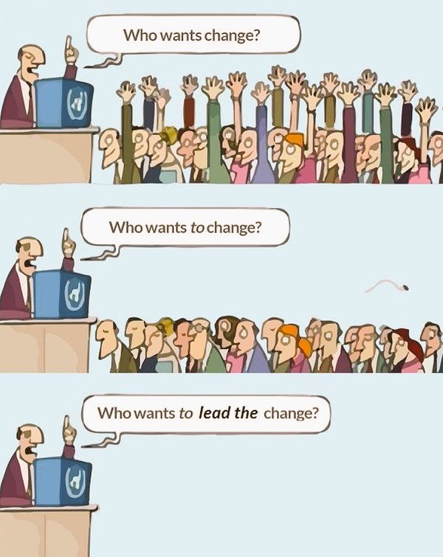
Leading change is tough
“And it ought to be remembered that there is nothing more difficult to take in hand, more perilous to conduct, or more uncertain in its success, than to take the lead in the introduction of a new order of things.”
Niccolo Machiavelli

Slide 15
Breakout: Leading Change vs Receiving Change
Breakout:
You are on the receiving end of major change.
What would you like your change leaders to do?

Slide 16
Ineffective change leadership stops with you!
So many delegates in so many organisations over the years have commented that
their leaders are not providing the quality of change leadership that we discuss in this workshop.
So … what are we to do?
Influence others (respectfully) to become better leaders of change
You become the type of change leader that you would like to experience

Slide 17
Essential ingredients of successful change

Slide 18
1. Clarity of what you are trying to achieve – and why
“If you don’t know where you are going, you’ll end up someplace else.”
Yogi Berra

Slide 19
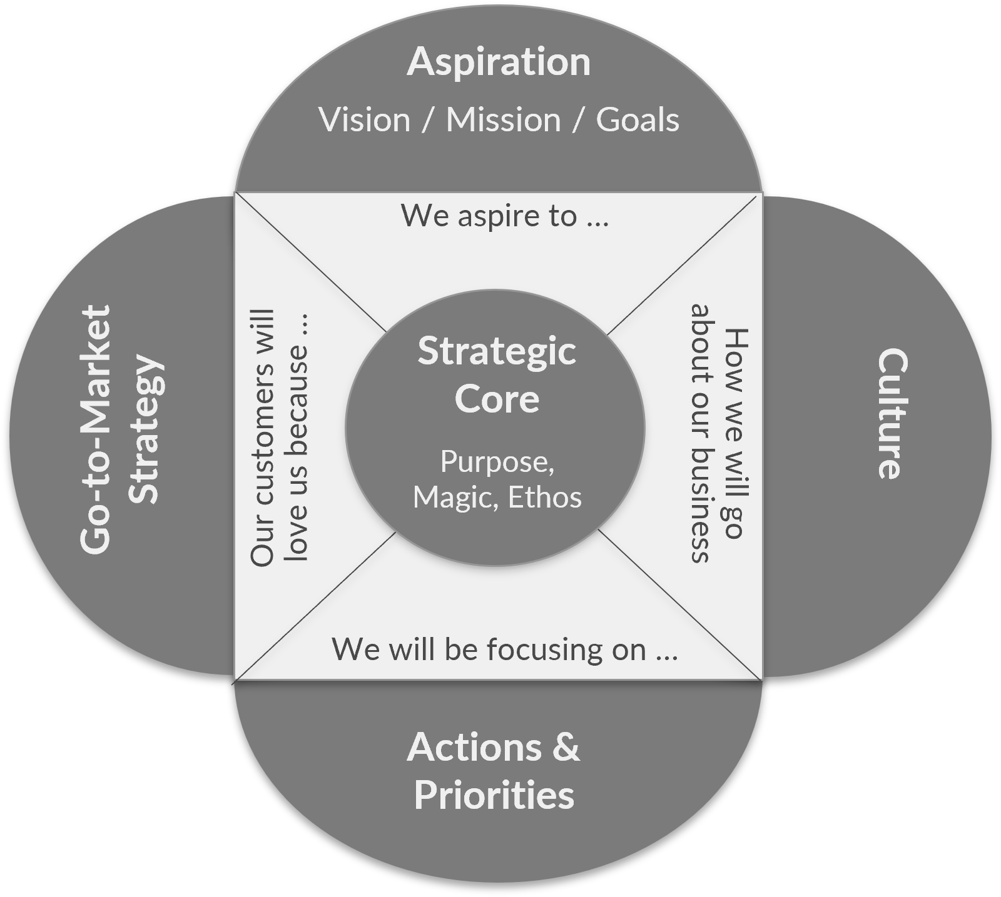
Clarity of what
Strategy
Magic
Things we don’t question
Questions we don’t ask
?
Notes:
Ask the audience a relevant question from this slide. Eg: What is the ‘magic’ of your team / department / TRP? Or What is the magic of how you work today that you don’t want to throw away in the new world?

Slide 20
… and why
Why do I need to change?
The right reason
The real reason

Slide 21
2. Ensure implications are fully understood
“There are downsides to everything;
there are unintended consequences to everything.”
Steve Jobs

Slide 22
Remember: Even good change is net good
Don’t let the pursuit of perfection
get in the way of ‘good’.
If change is 80% ‘good’, celebrate the 80%. Don’t lament the 20%!

Slide 23
3. Genuine communication and engagement
“The single biggest problem in communication is the illusion that it has taken place.”
George Bernard Shaw

Slide 24
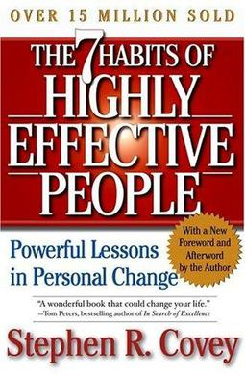
Genuine communication involves active listening
“The biggest communication problem is we do not listen to understand, we listen to reply.”
Stephen Covey

Slide 25
4. Appeal to people’s emotions
Emotions trump logic every time
“When dealing with people, remember you are not dealing with creatures of logic, but with creatures of emotion.”
Dale Carnegie
Notes:
Professor Dalmasio (Portuguese)

Slide 26
Engagement with change is 80% emotion, 20% logic
Emotional commitment is four times more powerful than rational commitment
‘’Driving Performance and Retention Through Employee Engagement.’ A study of 50,000 employees. 2004

Slide 27
Find their emotional triggers
How do you want them to feel? What is important to them?
What gets them excited about the future?
What makes them feel good about themselves? What motivates them?

Slide 28
5. Focus on outcomes
The operation was a complete success.
Unfortunately, the patient died.
PROCESS
OUTCOMES

Slide 29
6. Set people up to succeed
What do they need to succeed?
Personal:
Clarity
Confidence
Support
Empowerment
Organisational:
Appropriate Governance
Clear Decision-Making
Clear Processes

Slide 30
7. Overcome inertia
Mid-Term Inertia
Momentum too great
PAUSE FOR REFLECTION
Complacency
Success breeds failure
AVOID
AT ALL COSTS

Slide 31
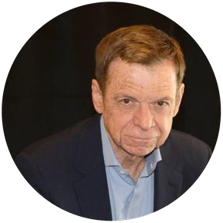
8. Build a change-ready culture / environment
“The central issue is never strategy, structure or systems.
The core of the matter is always about changing the behaviour of people.”
John P. Kotter.
Notes:
What is the culture like in your change project or team – virtual or otherwise?

Slide 32
The culture-change checklist: treat culture change like a project
Clarity of new behaviours – and why the need to change.
Motivation. Help people to want to adopt the new behaviours.
Skills. Help people to develop the new skills and approach they
need to change.
Tools. Give people the tools they need to maintain the change.
Rewards for adopting new behaviours and aligned incentives.
Consequences. What are the consequences of not changing?
Leadership. Leading by example.

Slide 33
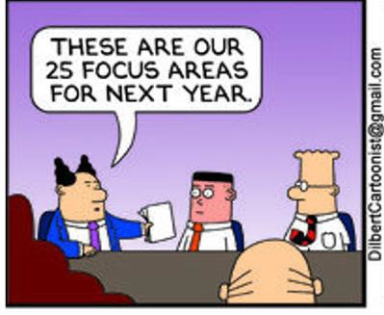
9. Committed, focused change leadership
Successful leaders of change never take their eye off the ball.
They continually focus on the high priority outcomes and nudge people back on to the path to deliver.

Slide 34
10. Be a catalyst for change
Dedicated business person
Focused on outcomes
High EQ
Genuine communicator – listens to understand
Excellent at stakeholder engagement
Works with project/programme manager
The ying to a PM’s yang
We can all be change catalysts

Slide 35
Essential ingredients to successful change
Clarity of what you are trying to achieve – and why
Ensure implications are completely understood
Genuine, two-way communications and engagement
Appeal to people’s emotions – find their emotional triggers
Focus on outcomes
Set people up to succeed
Overcome inertia
Build a change-ready culture / environment
Focused, committed change leadership
Be a catalyst for change
Which ones
resonated the most
and why?

Slide 36
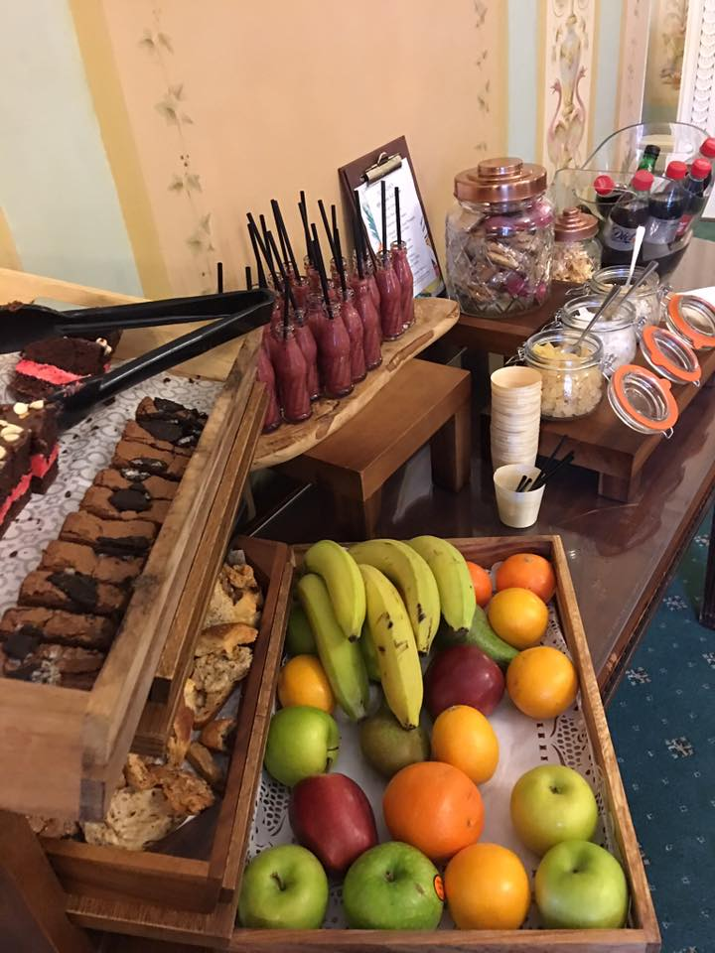
Break
15 mins

Slide 37
How we react to change

Slide 38
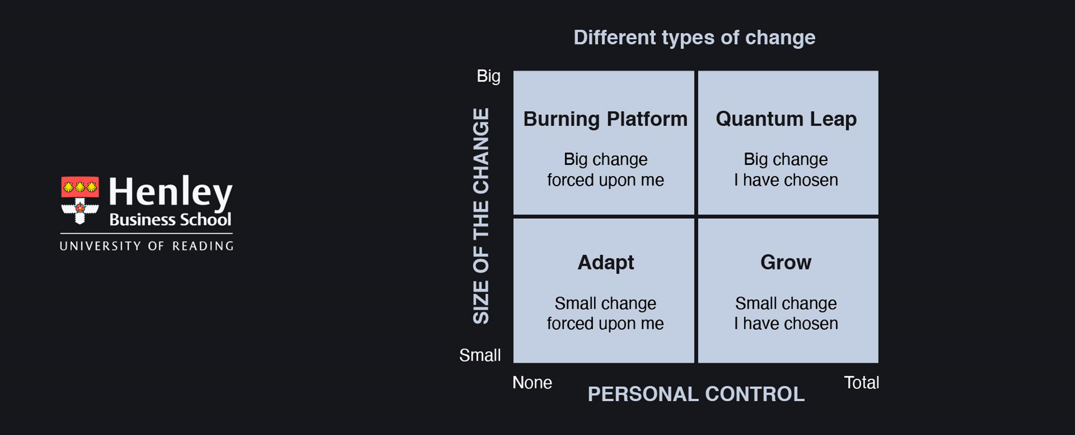
How we react to change: The Change Matrix

Slide 39
The Burning Platform Change Curve

Slide 40
Breakout: How to help people through the change curve
Resistance: How best to deal with people who are in shock and denial?
Frustration: How do you help people who are angry or scared?
The Trough: How do you help people who are mired in the trough?
Exploration: How to help people through understanding and acceptance?
Adoption: How to help make the change sustainable?
Notes:
Break into 4 or 5 groups

Slide 41
Beware: the trough is where victims dwell
Persecutor
Rescuer
“If it's never our fault, we can't take responsibility for it. If we can't take responsibility for it, we'll always be its victim.”
Richard Bach
Victim
Notes:
Discuss Karpman’s (1968) Drama Triangle and ask for how to get out of such a situation. The best way is to reframe how we view all three players including ourselves – stop thinking of yourself as Victim – isn't helpful. Regard yourself as a Creator (of opportunities). Look at the Persecutor as a Challenger. Ditch the Rescuer, even if they are a friend and replace them with a Coach. Someone who will give you lots of sympathy but then ask the vital question – what are you going to do about it? You can be your own coach.

Slide 42
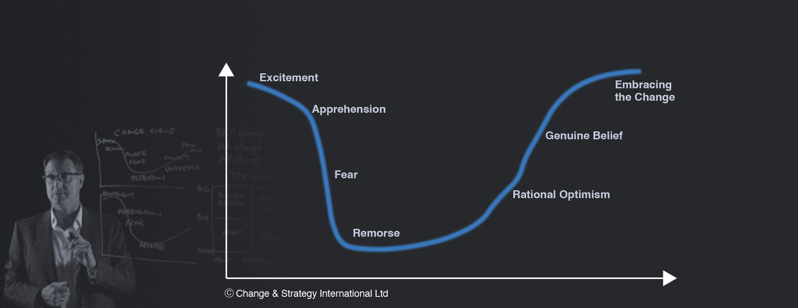
The Quantum Leap Change Curve
Our reaction to change we instigate
follows a similar pattern.
Notes:
Eg going for a promotion – and getting it

Slide 43
Too often, change leaders start from very different places on the matrix than the people who need to deliver it
Employees
Leaders

Slide 44
Overcoming our barriers to change
Admitting denial
Observing our emotions
Detaching from negative thoughts
Confronting our fears
Reframing our identity and status
Voicing our doubts and concerns
Accepting reality and uncertainty

Slide 45
2. Observing our emotions
We are not our emotions.
The simple act of observation gives us the detachment we need to realise this.
“Stop – Take a breath – Observe – Proceed”
Dalai Lama

Slide 46
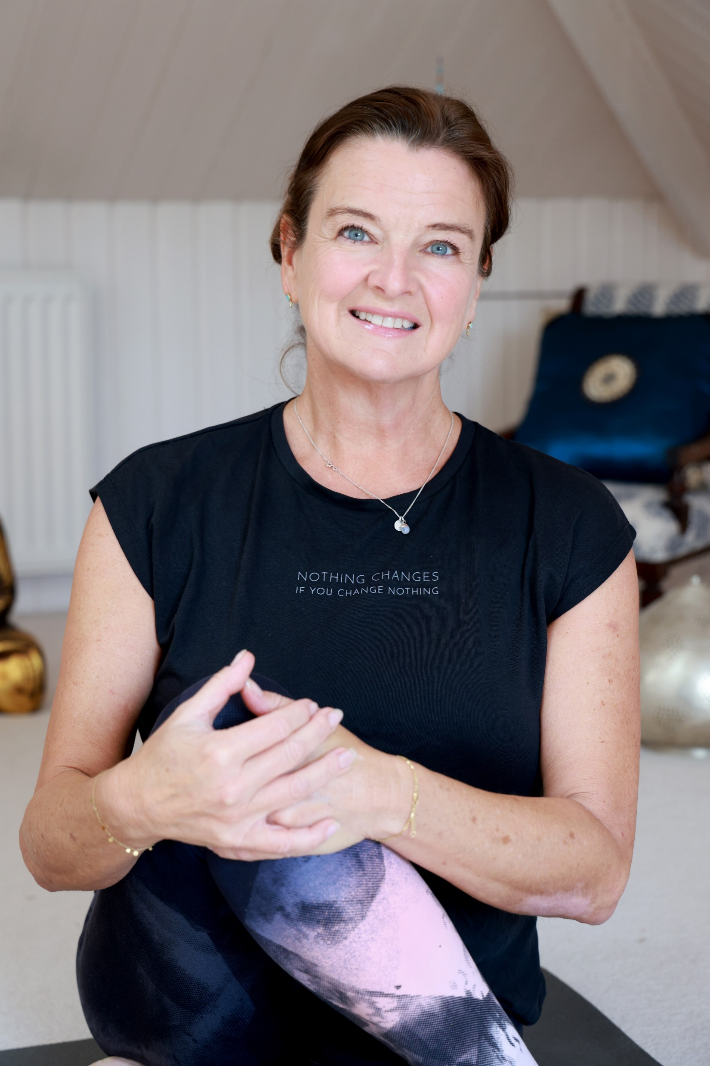
2. Detaching from our negative thoughts
Our negative thoughts are so powerful they can make us ill – and 80% of our thoughts are negative.
Chapter 22:
The Power
of Yoga

Slide 47
4. Confronting our fears
False Evidence Appearing Real
Fear of failure
Fear of rejection or humiliation
Fear of the unknown
Fear of blame

Slide 48
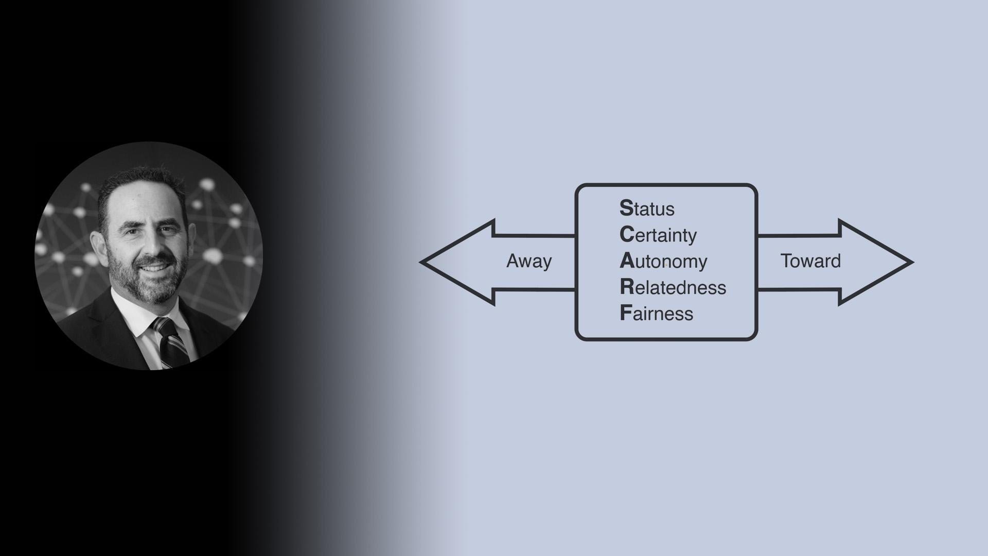
5. Reframing our identity or status
The SCARF Model
+ Purpose & Values
David Rock, Neuroscientist
Notes:
Think of a change project / new initiative. Who were the main change resistors. What may have been a cause of their resistance?

Slide 49
6. Voicing our doubts and concerns
“It’s as simple as this:
When people don’t unload their opinions and feel like they’ve been listened to,
they won’t really get on board.”
Patrick Lencioni

Slide 50
7. Accepting reality
“Grant me the serenity to accept the things I cannot change, the courage to change the things I can, and the wisdom to know the difference.”
Reinhold Niebuh (1892–1971)
Control
Influence
Observe

Slide 51
Acceptance: of what we can and cannot change
Make a list
Divide your list into three categories …
What thoughts are occupying your headspace right now?
Concerns?
Fears?
Things you wish were different?
Opportunities?
Those things you cannot change
Those things you can change on your own
Those things you can change with help / working with others
Notes:
Prepare 3 flip charts as per the slide. Ask everyone in the group to make a list of their key challenges/concerns/fears/etc that are currently occupying their headspace. Then transfer each point on the list to a post-it note and pin each post-it on the appropriate flip chart. Then ask if there is anything else they would add to each flip chart. Go through each flip chart with the group. Ask each delegate to identify which of each list they will start to work on straight away. (Homework – transform these two to-do lists into an action plan.)

Slide 52
Now you have two to-do lists
Make a list
Divide your list into three categories …
What thoughts are occupying your headspace right now?
Challenges?
Concerns?
Fears?
Things you wish were different?
Opportunities?
Those things you cannot change
Those things you can change on your own
Those things you can change with help / working with others
Notes:
Prepare 3 flip charts as per the slide. Ask everyone in the group to make a list of their key challenges/concerns/fears/etc that are currently occupying their headspace. Then transfer each point on the list to a post-it note and pin each post-it on the appropriate flip chart. Then ask if there is anything else they would add to each flip chart. Go through each flip chart with the group. Ask each delegate to identify which of each list they will start t work on straight away. (Homework – transform these two to-do lists into an action plan.)

Slide 53
Resilience
What does resilience mean to you?
How to build and nurture it?

Slide 54
Building resilience
Remain hopeful
Make connections
Choose how you react
Accept that change is a part of life
Keep things in perspective
Forward momentum in small steps
Take decisive actions
Make every day meaningful
Learn from experience
Look for opportunities
Like and take care of yourself
Be proactive
Courtesy of The Mayo Clinic and The American Psychological Association

Slide 55
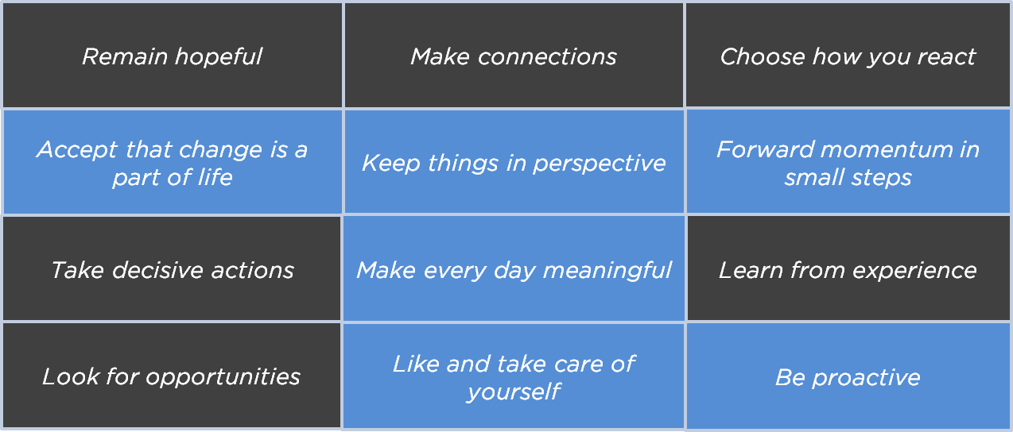
Building resilience

Slide 56
Building resilience

Slide 57
It’s all about change
“It is not the strongest of the species that survive, nor the most intelligent,
but the one most responsive to change.”
Charles Darwin

Slide 58
What are your ‘light bulb moments’ from today?
Notes:
In any meeting or workshop, if you can walk away with just one ‘light bulb moment’ it has been worthwhile. We are hoping you will have dozens of such moments throughout this program. Use your program notebooks to jot down ideas as they come to you during the workshop – pieces of insight, ideas, actions, things that resonated with you the most.

Slide 59
What are you going to: Stop Doing Start Doing Continue Doing as a result of today? (Be prepared to answer this question in the group mentoring session)
Notes:
In this workshop, I want you to go further than simply jot down light bulb moments. I want you to answer the above question at the end of the session.

Slide 60
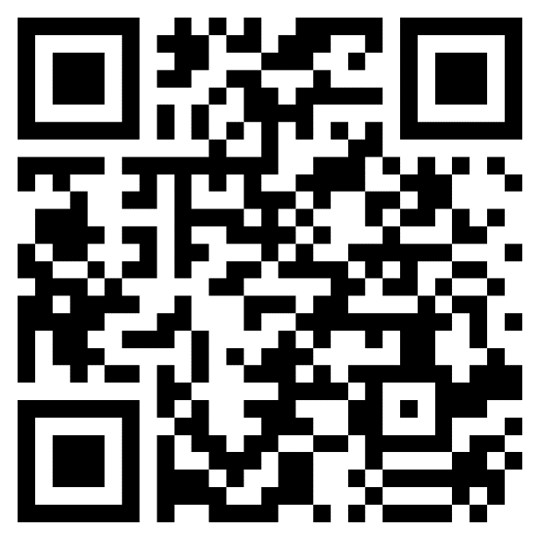
TRP HR asking for feedback after each workshop
Course Evaluation
Please access course evaluation through the URL or QR Code.
Link https://forms.office.com/r/m5mLDcfkmk

Slide 61
e: campbell@changeandstrategy.com

