Slide 1
APAC AIC program
2023
‘Leading with influence’
WORKSHOP 1:
Emotionally Intelligent Leadership
Campbell Macpherson
Change and Strategy International
Notes:
The AIC Program has been designed to enable T. Rowe Price’s next generation of senior leaders to develop and utilise key skills that will help them to ‘lead with influence’.
The content has been designed to:
Hone key skills that will enhance your effectiveness, increase your influence, enhance your ability to drive change and maximise your impact at T. Rowe Price
Tackle real-life challenges
Be insightful and pragmatic – with input from TRP Senior Executives
We are continually enhancing it – so need your feedback when HR reaches out to you

Slide 2
AIC: rolling out across EMEA, US and APAC
Notes:
The first EMEA cohort was Sep 2022 – Mar 2023. US is in the process of running it online across two cohorts. APAC – Singapore, Sydney, HKG and Tokyo.
Talk about continuous improvement – that we want keep improving with each workshops we roll out.

Slide 3
Advanced Individual Contributor (AIC)
The AIC Program has been designed to enable T. Rowe Price’s next generation of senior leaders to develop and utilise key skills that will help them to ‘lead with influence’.
The content has been designed to:
Hone key skills that will enhance your effectiveness, increase your influence, enhance your ability to drive change and maximise your impact at T. Rowe Price
Tackle real-life challenges
Be insightful and pragmatic – with input from TRP Senior Executives
It has also been enhanced as a result of the first EMEA cohort in 2022/2023.

Slide 4
Our expectations of you
Notes:
A repeat of a slide from the launch

Slide 5
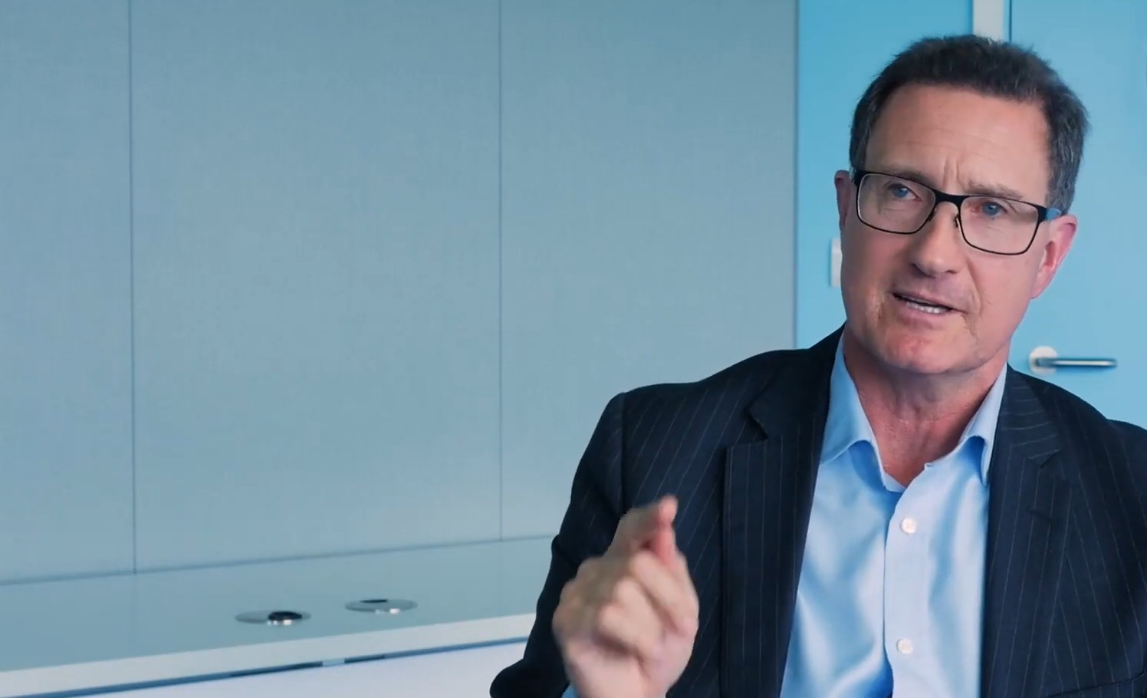
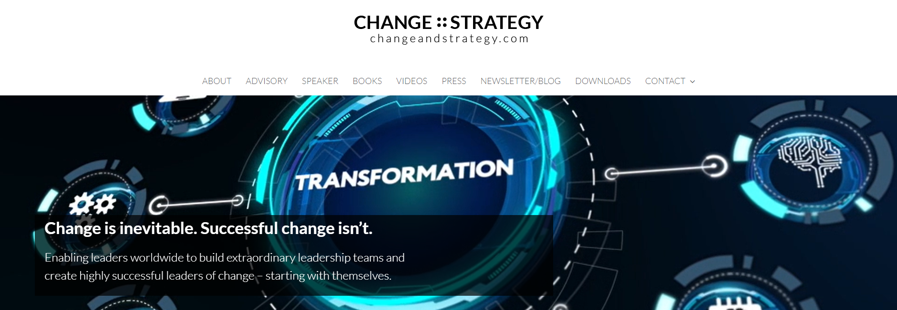
Your Facilitator: Campbell Macpherson
International business adviser, change leadership expert, keynote speaker,
author and Executive Fellow of Henley Business School
Notes:
Tailor to the facilitator

Slide 6
Your Program
The program is designed to build different elements of the skills you need to ‘lead with influence’.
Kick-off Session
HBDI and Program Overview
Workshop 1
Emotionally Intelligent Leadership
Putting EQ into practice
Workshop 2
Communication that Works
Communicating technical material, w/out diminishing expertise
Workshop 3
Leading and Embracing Change
Incl. Stakeholder Engagement
Workshop 4
Influencing without Authority
Incl. Managing Upwards & across continents
Peer Mentor
Session
90 min session for each delegate
Group
Session
90 min group mentoring session
Notes:
The Peer Mentoring session will cover the content of workshops 1 and 2. You will present and discuss two things to 5 of your peers: 1. The results of your EQ Assessment Questionnaire, and 2. Changes you will make to a key piece of communication – but more about both of those later.

Slide 7
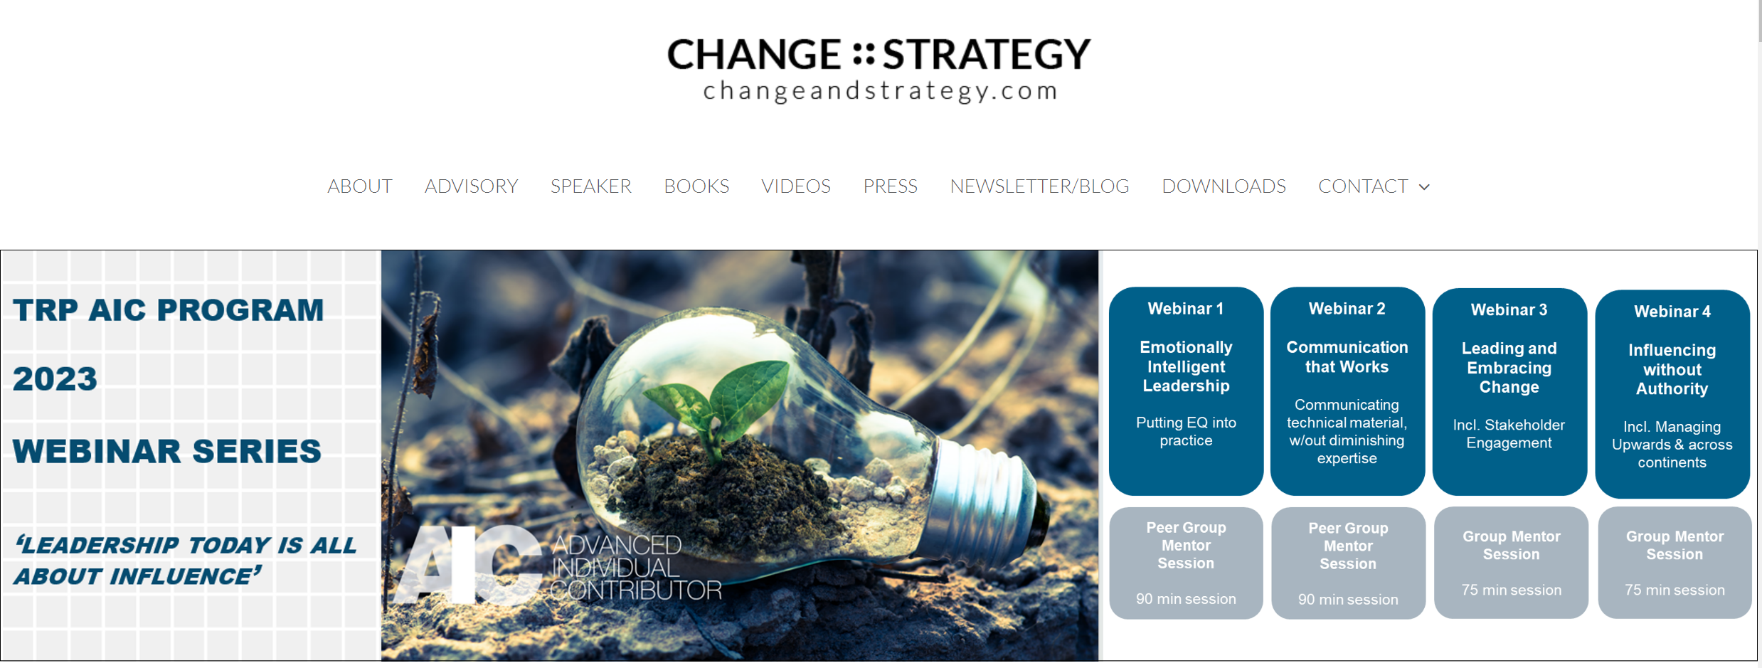
Your Resource Portal
https://www.changeandstrategy.com/trp-apac-aic-2023/ Password: TRPAIC

Slide 8
Your Resource Portal
https://www.changeandstrategy.com/trp-apac-aic-2023/ Password: TRPAIC

Slide 9
Today: Emotionally Intelligent Leadership
1 hr 30 mins Influential Leadership | Key themes Introductions and expectations Leaders v Influencers breakout and discussion The Chequerboard of Leadership Where are you on the Chequerboard?
15 mins | Break
1 hr 30 mins EQ | Moving northwards and eastwards Emotional Intelligence EQ assessment and discussion with peers Putting EQ into practice
15 mins | Light bulb moments Preparation for peer mentoring session Intro to workshop 2

Slide 10
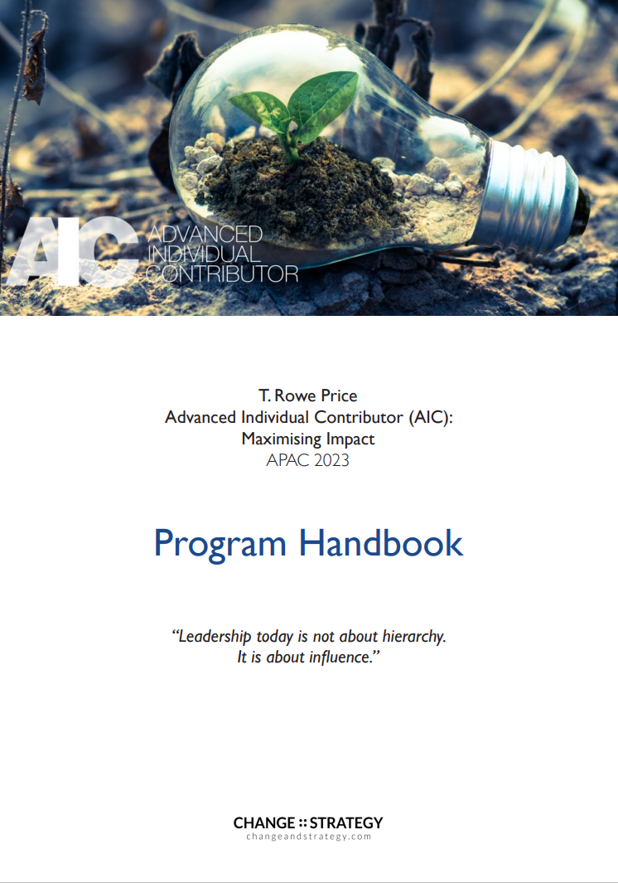
Use your handbook to capture your ‘light bulb moments’
Notes:
In any meeting or workshop, if you can walk away with just one ‘light bulb moment’ it has been worthwhile. We are hoping you will have dozens of such moments throughout this program. Use your program notebooks to jot down ideas as they come to you during the workshop – pieces of insight, ideas, actions, things that resonated with you the most.

Slide 11
Key themes that underpin the program
We are all leaders.
Leaders exist at all levels of an organisation, whether we manage people or not.
Influence is not manipulation. It is about ensuring mutual understanding and working with people to deliver enhanced outcomes.
EQ is twice as important as IQ when it comes to performance, leadership and career success.
If we are not influencing change we are not influencing anything, we are merely trying to prolong the status quo.
Leadership today is about helping people to want to change.
“Great things in business are never done by one person. They’re done by a team of people.”
Steve Jobs

Slide 12
“LEADERSHIP TODAY HAS NOTHING TO DO WITH HIERARCHY.
IT HAS EVERYTHING TO DO WITH INFLUENCE.”
Campbell Macpherson
Author of 2018 Business Book of the Year
www.changeandstrategy.com
Notes:
This progamis aimed

Slide 13
HBDI underpins each module
Analyzer
Strategizer
Understanding your thinking style preferences and the thinking style preferences of others is the backbone of:
Emotional Intelligence
Effective communication
Leading, influencing and embracing change
Influencing without authority
Organizer
Personalizer

Slide 14
Introducing yourself
Notes:
Due to time constraints - ask them to turn to introduce themselves using their profile in small groups; perhaps even just to do it with the person next to you.

Slide 15
Leaders vs Influencers - breakout
Leaders
1. How do poor leaders make you feel?
2. What are the traits of a good leader?
Influential People
3. How do people who are poor influencers make you feel?
4. What are the traits of a highly influential person?
Notes:
Divide into 4 groups, preferably with flipcharts if a big group, but

Slide 16
Extraordinary leaders …
Accept accountability, make decisions and deliver - superior and sustainable results
Are clear about what they are seeking to achieve - and why
Understand that every decision has implications and consequences
Engage others in the development and delivery of the strategy and are agile when it comes to implementation
Extraordinary leaders are inclusive.
They are emotionally intelligent leaders.
They lead with influence.
Delivery
Possess integrity. They are trusted and authentic. Lead by example.
Combine humility with confidence. Don’t think of themselves first.
Care: about the outcomes, the organisation, people and customers
Customer centric
Personal Qualities
Lead, influence and embrace change
Empower and develop their people. They create more leaders not more followers. They enable people to shine.
Embrace stewardship. They strive to leave their part of the business in a better state than they found it.
Build extraordinary leadership teams
Special Skills
Notes:
Discuss

Slide 17
Extraordinary influencers … do the same
Accept accountability, make decisions and deliver - superior and sustainable results
Are clear about what they are seeking to achieve - and why
Understand that every decision has implications and consequences
Engage others in the development and delivery of the strategy and are agile when it comes to implementation
Possess integrity. They are trusted and authentic. Lead by example.
Combine humility with confidence. Don’t think of themselves first.
Care: about the outcomes, the organisation, people and customers
Customer centric
Lead, influence and embrace change
Empower and develop their people. They create more leaders not more followers. They enable people to shine.
Embrace stewardship. They strive to leave their part of the business in a better state than they found it.
Build extraordinary leadership teams
Delivery
Personal Qualities
Special Skills

Slide 18
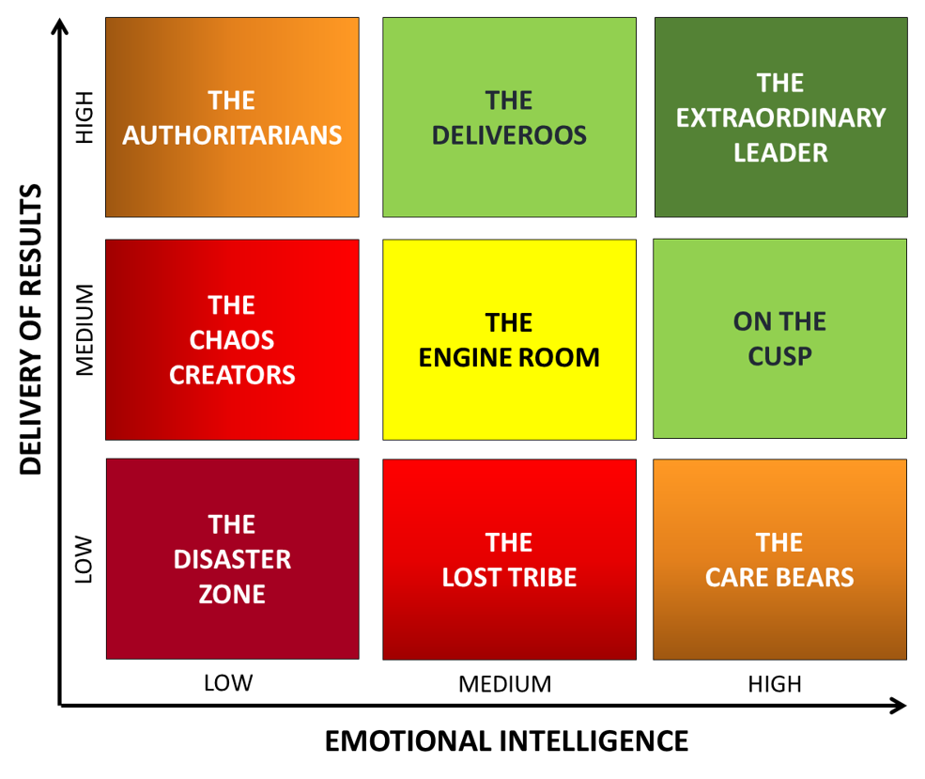
The Chequerboard of Leadership
The whole point of leadership is to deliver results - through people.
Leaders who don’t deliver won’t be leaders for long.
Only emotionally intelligent leaders are able to deliver superior, sustainable results because they engage and motivate others to deliver.
Notes:
The Chequerboard of Leadership came about when Campbell plotted the two key elements of leadership on a blank page – delivery and EQ. Too many leadership texts tend to gloss over the key point of leadership – that it is about delivery. And low EQ leaders deliver results that are short-term; unsustainable.

Slide 19
The Chequerboard of Leadership
“Leadership is the art of getting someone else to do something you want done because they want to do it.”
Dwight D. Eisenhower
Notes:
Too many leadership texts tend to gloss over the key point of leadership – that it is about delivery.

Slide 20
The Chequerboard of Leadership
The Disaster Zone:
Ineffectual and ineffective
Unaware
Likely to have already left

Slide 21
The Chequerboard of Leadership
The Chequerboard of Leadership
Chaos Creators:
Single-minded
Not as empathetic as they think they are
Outwardly confident
Can leave chaos in their wake

Slide 22
The Chequerboard of Leadership
The Authoritarians:
Delivers results no matter what
May regard EQ as ‘woke’ nonsense
Often gets result through fear or blatantly appealing to others’ naked self-interest
You are either ‘on the bus or you are under it’

Slide 23
The Chequerboard of Leadership
The Lost Tribe:
Unsure how to deliver – and knows it is an issue
Can succeed with help
Possibly in the wrong job

Slide 24
The Chequerboard of Leadership
The Engine Room:
The backbone of the organisation

Slide 25
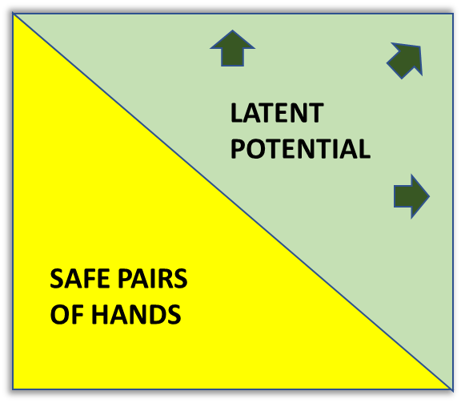
The Chequerboard of Leadership
The Engine Room:
The backbone of the organisation
Can be split into (at least) two:
Safe pairs of hands
Latent Potential
Opportunity to develop even further

Slide 26
The Chequerboard of Leadership
The Deliveroos:
The stars of your organisation
Renowned for delivery
Focuses on outcomes as well as outputs
The potential to be extraordinary

Slide 27
The Chequerboard of Leadership
The Care Bears:
Focused on wellbeing and welfare
Consensus very important
A rescuer (loves to rescue Victims)
Too busy with all of the above to deliver
Notes:
Draw Kaplan’s Victim Triangle on flip chart and discuss

Slide 28
The Chequerboard of Leadership
On the cusp:
Your future superstars
Naturally empathetic
Knows that buy-in and team consensus leads to more sustainable outcomes
Needs experience and consistent confidence
The potential to be extraordinary

Slide 29
The Chequerboard of Leadership
Extraordinary Leaders:
Know that delivery is paramount and sustainable outcomes are only possible through engaged and motivated people
Rare to find – something to strive for
Requires effort to attain and maintain

Slide 30
Where are you on the Chequerboard?
Where would you place yourself on the Chequerboard?
Where would your manager place you?
Where would you peers place you?
Why?
[Discuss in pairs]

Slide 31
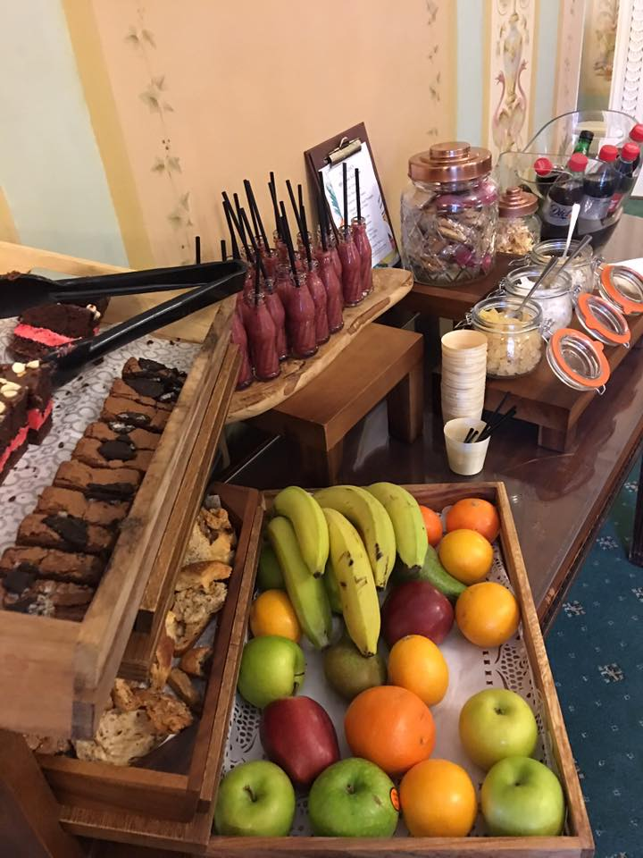
Break
15 mins

Slide 32
Moving Northwards: Building delivery skills
How do you think we can build delivery skills?
(Traits of people who are really good at delivery)

Slide 33
Moving Northwards: Building delivery skills
Clear business case and delivery plan
Attitude: a determination to deliver
Focus on outcomes
Achieve milestones
Identify interdependencies
Incentivise others to deliver what you need

Slide 34
Moving Eastwards: Developing our emotional intelligence

Slide 35
EQ vs IQ
EQ accounts for 67% of the abilities deemed necessary for superior performance (in leadership). It matters twice as much as technical expertise or IQ.
Harvard reported a zero or negative correlation between IQ and subsequent career success.
It’s all about EQ.

Slide 36
Emotional Intelligence
?
What does Emotional Intelligence mean to you?

Slide 37
Emotional Intelligence
Emotional Intelligence is your ability to:
Understand yourself
Understand other people -
what motivates them and how to work cooperatively with them.

Slide 38
5 Categories of Emotional Intelligence
Self-control
Relationship
Management
Motivation
Empathy
Self-awareness
Self-confidence
Humility
Observation
Self-honesty
Impact
Controlling emotions
Detachment
Integrity
Adaptability
Respect and good intentions
Understand implications
Understand why: right reason / real reason
Embrace diversity of views
Social awareness
Listening to understand
Clear communications
Scanning
Collaboration and compromise
Manage conflicts with honesty and respect
Relationship
Management
Motivate self and others
Driven. Desire to deliver.
Change Catalyst.
Optimistic and proactive
Clarity
Goleman’s four categories
Notes:
Discuss each section of the chart – guided details contained in the pre-workshop reading (handed out during workshop)

Slide 39
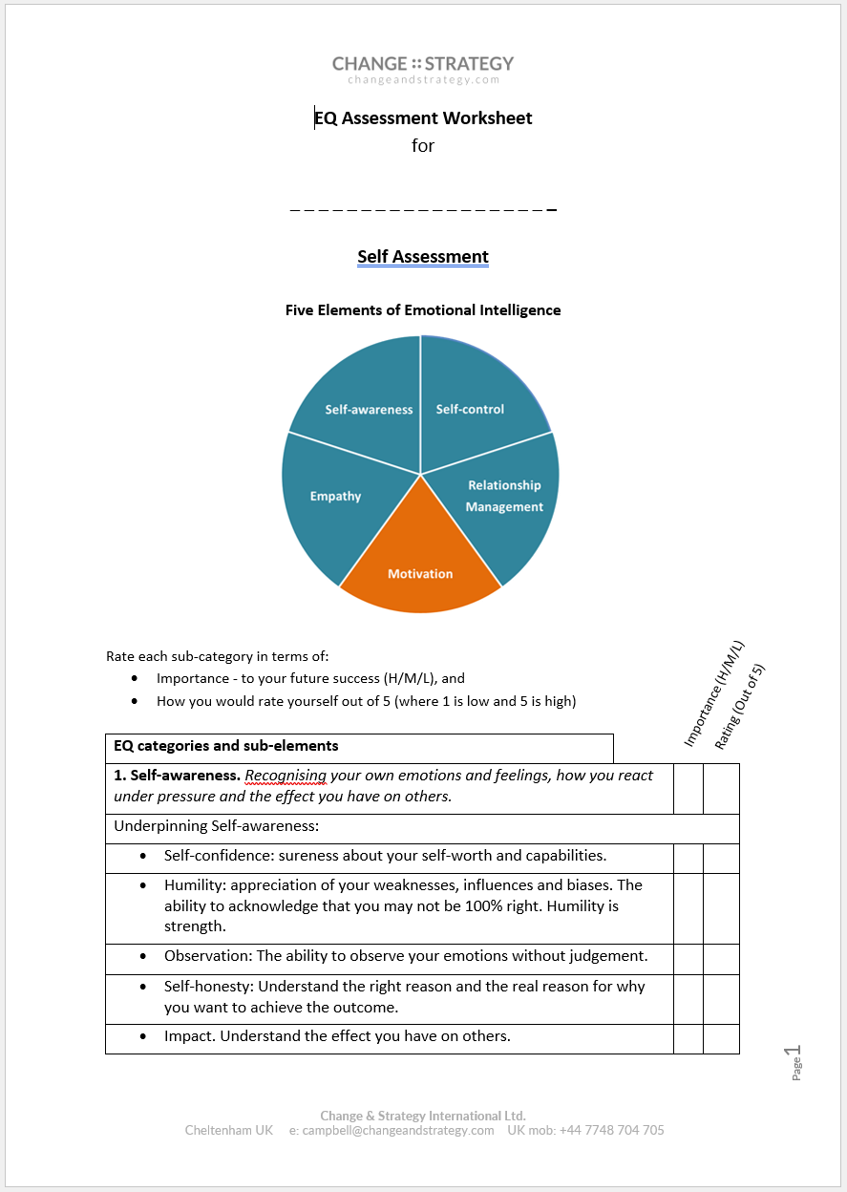
EQ Self-Assessment
Using the EQ Assessment Worksheet:
Rate each component (H/M/L) in terms of importance to your role and/or your career
Score yourself today out of 5
Identify which areas you think you need to work on
Discuss your ratings and conclusions with a colleague
Notes:
Hand out EQ assessment worksheets

Slide 40
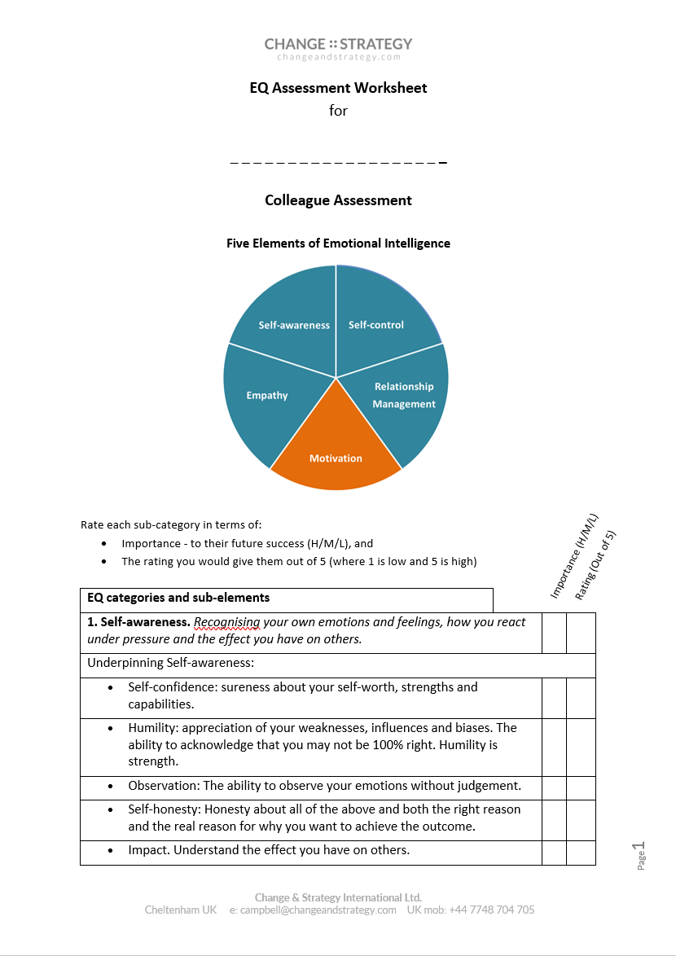
EQ Colleague Assessment
Before the peer mentoring session
Download the Colleague EQ Assessment Worksheet from the portal
Ask a colleague to fill out the colleague assessment on you.
Come prepared to talk to your peers about the differences between the two – and your top priorities when it comes to developing your emotional intelligence.
Notes:
Hand out EQ assessment worksheets

Slide 41
Your Resource Portal
https://www.changeandstrategy.com/trp-apac-aic-2023/ Password: TRPAIC

Slide 43
Your Program
The program is designed to build different elements of the skills you need to ‘lead with influence’.
Kick-off Session
HBDI and Program Overview
Workshop 1
Emotionally Intelligent Leadership
Putting EQ into practice
Workshop 2
Communication that Works
Communicating technical material, w/out diminishing expertise
Workshop 3
Leading and Embracing Change
Incl. Stakeholder Engagement
Workshop 4
Influencing without Authority
Incl. Managing Upwards & across continents
Peer Mentor
Session
90 min session for each delegate
Group
Session
90 min group mentoring session
Notes:
The Peer Mentoring session will cover the content of workshops 1 and 2. You will present and discuss two things to 5 of your peers: 1. The results of your EQ Assessment Questionnaire, and 2. Changes you will make to a key piece of communication – but more about both of those later.

Slide 44
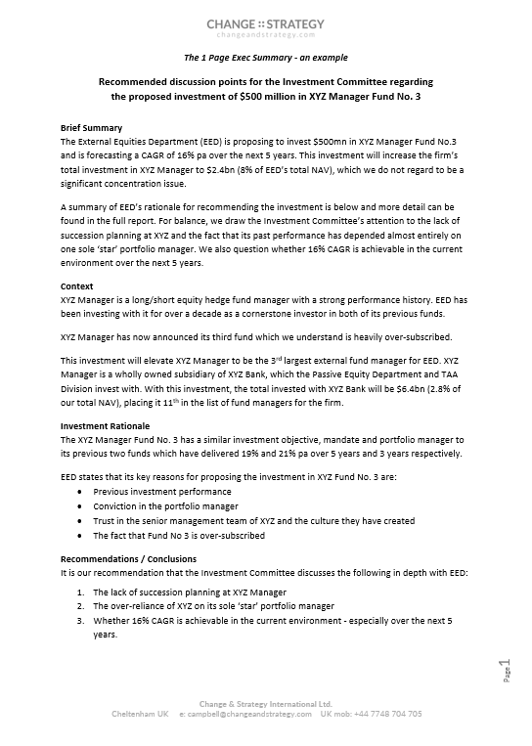
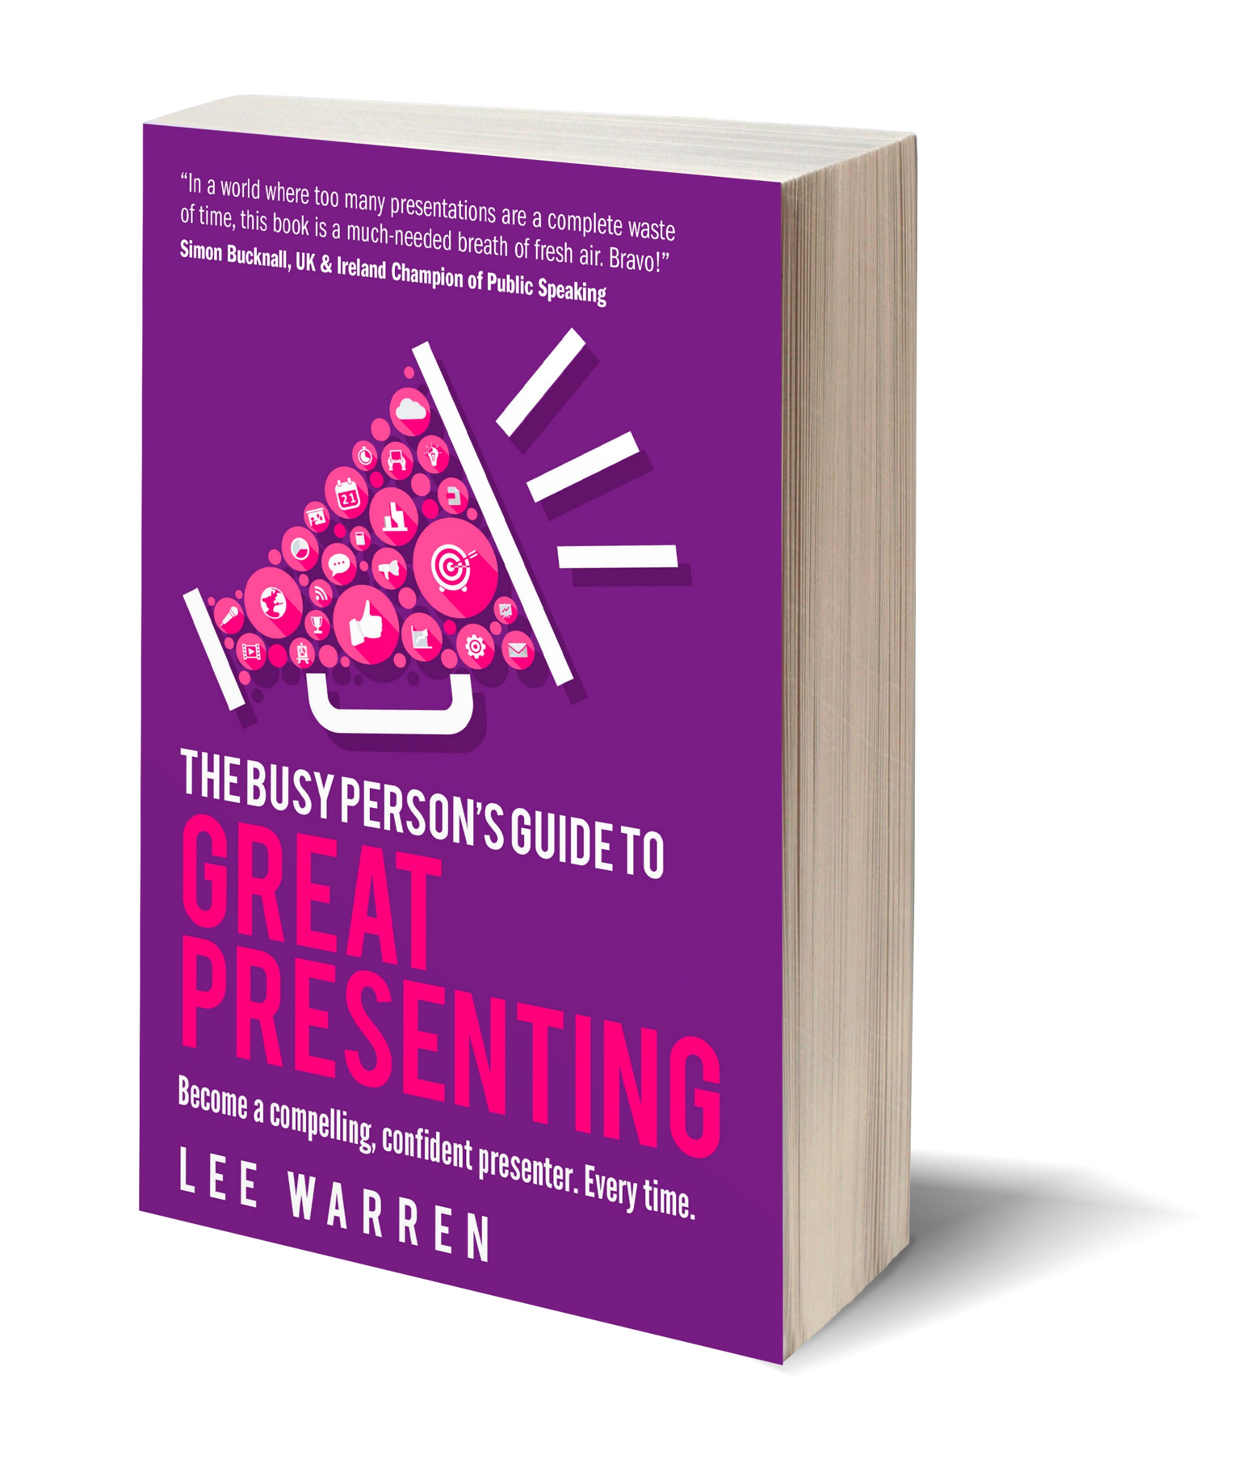
Workshop 2: Communication that Works
Every effective piece of communication is:
An opportunity to influence someone to think, feel or do something, and
Two-way.
This module will help you to enhance your communication style and impact. For Subject Matter Experts , it will help you to communicate technical material - in written form and in presentation form - concisely and clearly without diminishing your expertise.
Contents of the workshop:
Generic secrets of effective communications
Influential written communications. Case studies/exercises.
Influential presentations.
NB: In the peer mentoring session, we will focus on a specific written piece or presentation of yours.
Workshop 2
Communication that Works
Communicating technical material, w/out diminishing expertise

Slide 45
Your Resource Portal
https://www.changeandstrategy.com/trp-apac-aic-2023/ Password: TRPAIC
View before
next workshop

Slide 46
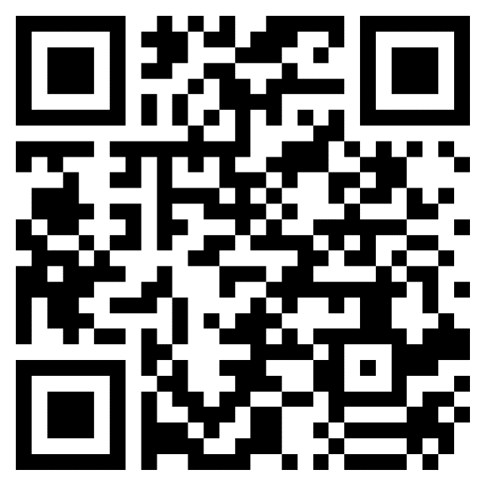
TRP HR asking for feedback after each workshop
Course Evaluation
Please access course evaluation through the URL or QR Code.
Link https://forms.office.com/r/m5mLDcfkmk

Slide 47
e: campbell@changeandstrategy.com

