Slide 1
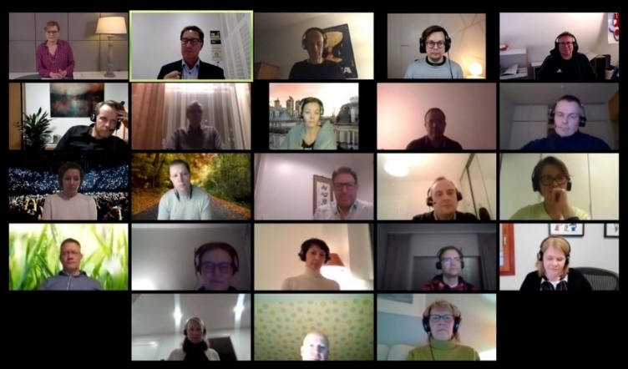
SLT webinar 2
Ways of Working
Creating an extraordinary leadership team
18 Jan 2021

Slide 2
AGENDA – WEBINAR 2 (HALF DAY)
WEBINAR 2: CREATING THE ENDSLEIGH DREAM TEAM
Session | Lead | Duration
Reflections from Session 1 | Group | 30 mins
Your Endsleigh ‘Dream team’ Desired characteristics of Endsleigh’s SLT. Implications. | Group | 45 mins
Speed dating session How the two of you work well together How the two of you could improve the way you work together |  | 1 hour
Grit in the oyster Endsleigh Org Structure (grey areas and solution options). | Group | 30 mins
Actions What will we do differently? What will I do differently? | Group | 45 mins
Keeping the momentum going / making it work | Group | 15 mins

Slide 3
REFLECTIONS FROM WEBINAR 1

Slide 4
REFLECTIONS
Alison’s recap
We’re 6 months in
Launched our strategy on the day we went home.
Passion to change, Passion to win
How translate that into the team that demonstration passion, bravery etc
We need to demonstration behaviours and ways of working to bring our teams along
Trust and a common goal are key for Alison
Trust comes from respect. Finding a way of working with each other.
Strong, purposeful and approachable team
We need to help each other to win - together

Slide 5
REFLECTIONS
Key takeaways from the book:
The importance of trust
Based on mutual respect, showing vulnerability and the ability to learn from mistakes
Trust takes time and knowing one another on a deeper level. Belief we are all coming from a good place.
And a common goal - one song, one story - you could feel the change in the story once they had a common goal.
The value of constructive conflict. (The book highlighted passive disagreement perfectly)
Understanding of strengths and weaknesses: a lot of the people thought their strengths were in areas were others thought differently and I think that can reflect on us as a team too.
Interesting to see if/how the 5 dysfunctions will come through in reality for us.
We’ve achieved a lot in 6 months - increasingly good debate within this team. Already gravitating to the right behaviours.
I like the fact that Alison will stop a debate and say right, that’s what we’re doing rather than endless discussions. We might not always agree, but we have to get behind it. We’ve had our chance to speak.

Slide 6
REFLECTIONS
Assumptive Truths
Any challenge is coming from a good place
Everyone has earned their place at this table & is here for a reason
The only reason we are here is to achieve results (balanced scorecard)
We are all accountable to this team and its performance – this is our first team
We commit to ‘living’ the Endsleigh behaviours in this team
Always think ‘and’ not ‘but’
Trust will be built on mutual respect, vulnerability, learning from mistakes
Air your concerns and then adopt cabinet responsibility

Slide 7
REFLECTIONS
What’s different about being a member of the SLT?
We are each accountable for our behaviours.
People look to us for confidence and belief.
Not just your function to have an opinion on, it’s the whole business and that view is welcome. Not only a right, but a responsibility.
Setting up processes, foundations and people rather than coming up with ideas myself. It’s about creating an environment for people to deliver.
Leader as mentor: coaching, listening and guiding rather than doing.
It’s about being a good grown up. Have to be objective, not take things personally and take a deep breath sometimes.
Understanding the level of conflict that we can tolerate as a team
Better when conflict isn’t seen as conflict it’s see as constructive feedback. If you’ve got trust within the room then there is the space to have those open conversations.
Also need people with quiet purpose and significant determination.
There is a way to be very effective calmly and effectively.

Slide 8
Extraordinary Leadership Teams
::
Extraordinary leadership teams are teams of highly effective leaders working together to deliver shared objectives.
Attributes:
Competent in own right
Respect through experience
Respect through attitude and approach
Reputation for delivery
Personal alignment to strategy
Integrity
Customer orientation
Individual
Effectiveness
Effectiveness
as a leader
Attributes:
Leads by example
Sets clear direction
Effective delegation
Listens to understand
Aligns & engages people
Creates more leaders
Stewardship
Empathetic
Authentic
Enables people to succeed
Leadership Team
Effectiveness
Attributes:
Team aligned to clear strategy and success metrics
Inter-departmental interdependencies clear
Collegiate - work together to deliver shared outcomes
Team goals more important than individual goals
Complimentary strengths offsetting others’ weaknesses
Robust but constructive discussion of issues
Creates a culture that enables delivery of the strategy
Foundation:
Mutual trust & respect
Clear accountabilities
Shared objectives
Clear interdependencies
Clear behavioural expectations
Clear decision-making processes
Cabinet responsibility
Cares about team and business

Slide 9
REFLECTIONS
What are your expectations of you/one another?
Keep our promises/do as we say.
Try your hardest. Care. As long as you’ve given it 100% - got to find a path to yes. This is about getting results. If you think something isn’t going to be achievable, call this out. Are we sure we can deliver on this? Followed up with rationale.
Always consider people, partners and customers. Without all 3, we don’t have a business.
Continue to support an open dialogue.
Be brave. Don’t be afraid to have some difficult conversations.
Support one other – help one another to grow.
Have a chat if you want to raise something. Build closer friendships.

Slide 10
REFLECTIONS
What do you expect of Alison?
Share a broader perspective. Story building and being informed of how that’s perceived in the group.
Good to have someone who can call it when things aren’t going as planned
Reminding us of the book and keeping us on the right path.
Be totally upfront and honest. We’re all in this together and working towards a common goal.
Whilst you’re our leader, we’re also here as your sounding board.
Keep setting the bar high.
Clarity (and honesty when the clarity isn’t there).
Make sure we have fun.

Slide 11
ALISON SUGGESTION RE CHALLENGING THE STRATEGY
1. A constraints and prioritisation session to balance the ambition of the business (enablers & projects) vs timing & resourcing – scheduled 25 January.
Everyone needs to level-set on the constraints of the business (action – Matt)
Matt will own the list of enablers and projects
All projects should have a 1 pager (the Nathan template)
As a team, we will score each initiative (1-3) in terms of customer impact, commercial impact, compliance impact, strategic importance.
2. A FCA Dual Pricing session will be held in 6-8 weeks time to discuss and debate the short, medium and long term impact and implications of the pending regulations.
3. Quarterly ‘Revisit the Strategy’ sessions will be held to use the brain power of this team, plus occasional guests, to debate Big Ticket items that could enhance or affect the strategy. Each session will be prepared for using the ‘What-How-When-Who-So What’ template.
I envisage two days off site – one on strategy and the other on culture / SLT
For the first session in May, I suggest we focus on our ‘Go To Market ‘strategy, and discuss:
The role of aggregators
The direct model
F2F / on campus selling and presence
Advised sales
Endsleigh Student Aggregator
End August session
Mid November (in time for FY23 budget)

Slide 12
YOUR ENDSLEIGH DREAM TEAM

Slide 13
YOUR ‘DREAM TEAM’: YOUR VISION FOR ENDSLEIGH’S SLT
What would you like to see this team do?
How would you like to see this team behave?
FOCUS / PRIORITIES
CHARACTERISTICS OF THE TEAM
ATTITUDES YOU WOULD LIKE TO SEE
BEHAVIOURS YOU WOULD LIKE TO SEE

Slide 14
Implications
“There are downsides to everything; there are unintended consequences to everything.”
Steve Jobs

Slide 15
1 TO 1 SPEED DATING SESSIONS

Slide 16
WORKING WITH ONE ANOTHER 1 of 10
Speed dating in Zoom breakout groups
1 on 1 brief sessions:
How the two of you work well together
How the two of you could improve the way you work together
Room 1 | Room 2 | Room 3 | Room 4 | Room 5
Alison | Ed | Jacquie W | Julie-Ann | Zoe
Alastair | Jackie B | Jason | Matt | Jane

Slide 17
WORKING WITH ONE ANOTHER 2 of 10
Speed dating in Zoom breakout groups
1 on 1 brief sessions:
How the two of you work well together
How the two of you could improve the way you work together
Room 1 | Room 2 | Room 3 | Room 4 | Room 5
Alison | Ed | Jacquie W | Julie-Ann | Zoe
Jackie B | Jason | Matt | Jane | Alastair

Slide 18
WORKING WITH ONE ANOTHER 3 of 10
Speed dating in Zoom breakout groups
1 on 1 brief sessions:
How the two of you work well together
How the two of you could improve the way you work together
Room 1 | Room 2 | Room 3 | Room 4 | Room 5
Alison | Ed | Jacquie W | Julie-Ann | Zoe
Jason | Matt | Jane | Alastair | Jackie B

Slide 19
WORKING WITH ONE ANOTHER 4 of 10
Speed dating in Zoom breakout groups
1 on 1 brief sessions:
How the two of you work well together
How the two of you could improve the way you work together
Room 1 | Room 2 | Room 3 | Room 4 | Room 5
Alison | Ed | Jacquie W | Julie-Ann | Zoe
Matt | Jane | Alastair | Jackie B | Jason

Slide 20
WORKING WITH ONE ANOTHER 5 of 10
Speed dating in Zoom breakout groups
1 on 1 brief sessions:
How the two of you work well together
How the two of you could improve the way you work together
Room 1 | Room 2 | Room 3 | Room 4 | Room 5
Alison | Ed | Jacquie W | Julie-Ann | Zoe
Jane | Alastair | Jackie B | Jason | Matt

Slide 21
WORKING WITH ONE ANOTHER 6 of 10
Speed dating in Zoom breakout groups
1 on 1 brief sessions:
How the two of you work well together
How the two of you could improve the way you work together
Room 1 | Room 2 | Room 3 | Room 4 | BYE
Alison | Jacquie W | Alastair | Jason | Zoe
Ed | Julie-Ann | Jackie B | Matt | Jane

Slide 22
WORKING WITH ONE ANOTHER 7 of 10
Speed dating in Zoom breakout groups
1 on 1 brief sessions:
How the two of you work well together
How the two of you could improve the way you work together
Room 1 | Room 2 | Room 3 | Room 4 | BYE
Alison | Ed | Alastair | Jackie B | Julie-Ann
Jacquie W | Zoe | Jason | Jane | Matt

Slide 23
WORKING WITH ONE ANOTHER 8 of 10
Speed dating in Zoom breakout groups
1 on 1 brief sessions:
How the two of you work well together
How the two of you could improve the way you work together
Room 1 | Room 2 | Room 3 | Room 4 | BYE
Alison | Ed | Alastair | Jackie B | Jacquie W
Zoe | Julie-Ann | Jane | Matt | Jason

Slide 24
WORKING WITH ONE ANOTHER 9 of 10
Speed dating in Zoom breakout groups
1 on 1 brief sessions:
How the two of you work well together
How the two of you could improve the way you work together
Room 1 | Room 2 | Room 3 | Room 4 | BYE
Alison | Jacquie W | Alastair | Jason | Ed
Julie-Ann | Zoe | Matt | Jane | Jackie B

Slide 25
WORKING WITH ONE ANOTHER 10 of 10
Speed dating in Zoom breakout groups
1 on 1 brief sessions:
How the two of you work well together
How the two of you could improve the way you work together
Room 1 | Room 2 | Room 3 | Room 4 | BYE
Ed | Julie-Ann | Jackie B | Matt | Alison
Jacquie W | Zoe | Jason | Jane | Alastair

Slide 26
POINTS OF DISCUSSSION

Slide 27
ENDSLEIGH’S ORG STRUCTURE
No structure is perfect. What are the questions around the current structure and what do we have to do to work around them?
GAPS IN ACCOUNTABILITY
?
OVERLAPS
?
SOLUTIONS – WORK-AROUNDS
?

Slide 28
ACTIONS

Slide 29
ACTIONS RE SLT WAYS OF WORKING
WHAT WILL WE DO DIFFERENTLY
?
WHAT WILL I DO DIFFERENTLY
?
Stop . Start . Continue ?
How will we ‘call one another out’?

Slide 30
MAINTAINING THE MOMENTUM

Slide 31
HOW WILL WE KEEP THE MOMENTUM GOING?

Slide 32
HOW WILL WE KEEP THE MOMENTUM GOING?
Ideas:
Document ways of working and SLT behaviours / sign up to ‘SLT charter’
Hold quarterly sessions to pause, reflect and enhance how the team operates
Include team assessment, individual assessment re default behaviours, learning styles, decision-making processes, …
Include session on leadership development – eg delegation and empowerment
…?

Slide 33
SPARE SLIDES

Slide 34
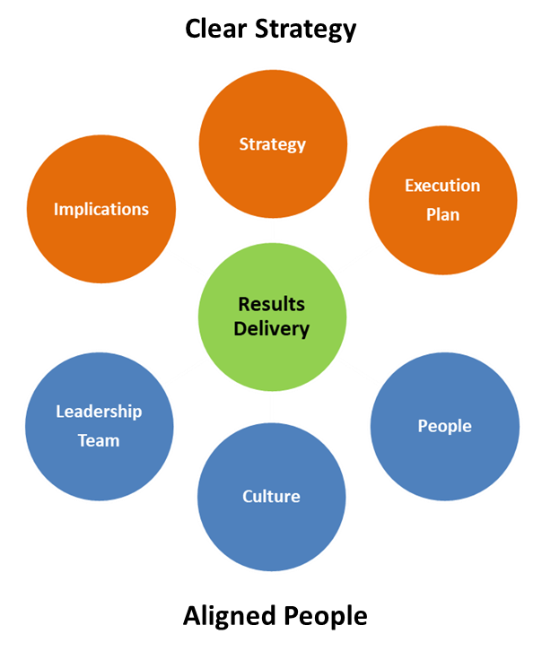
Great Leaders
::
Are trusted
Like people
Like themselves
Are empathetic
Build extraordinary leadership teams
Create more leaders
Enable their people to shine
Embrace stewardship – they strive to leave the business in a better state than they found it.
Combine humility with confidence
Change their minds when a better solution arises or facts change
Share the credit and take the blame
Are authentic / genuine
Deliver results - via a clear strategy and aligned people

Slide 35
Great Leaders
::
Help their people to want to change

Slide 36
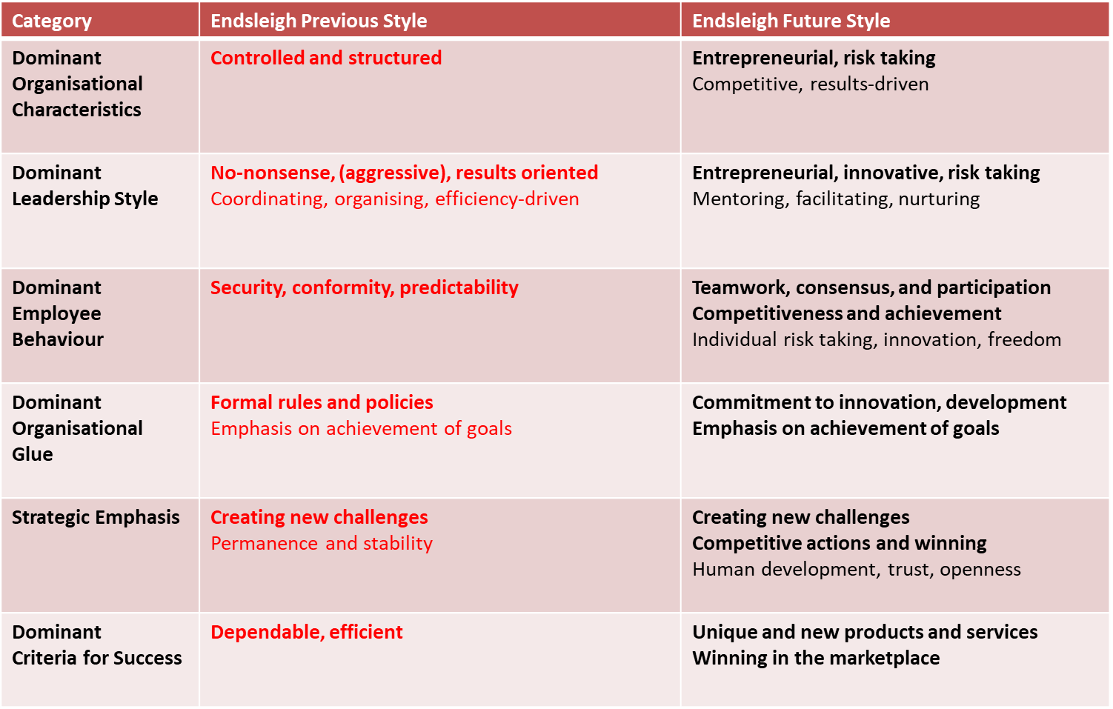
THE COMPETING VALUES FRAMEWORK
Key implications for the SLT ?

