Slide 1
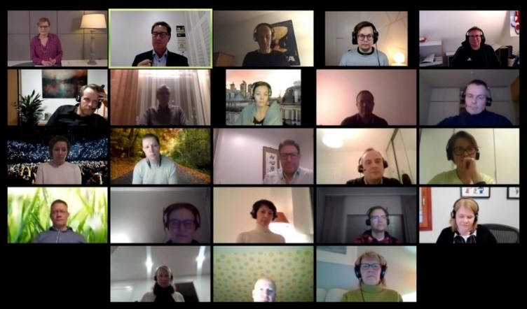
SLT webinar 1
Ways of Working
Creating an extraordinary leadership team
14 Jan 2021

Slide 2
WHY ARE WE HERE TODAY?
To work together to create a highly effective leadership team

Slide 3
AGENDA
WEBINAR 1: LEADERSHIP TEAMS AND EXPECTATIONS
Recap of where have we got to
A successful leadership team
Five Dysfunctions of a Team
When teams work well
Working together - 1:1 speed dating
Expectations – of each individual member, of Alison
WEBINAR 2: CREATING THE ENDSLEIGH DREAM TEAM
Reflections from Session 1
Your Endsleigh ‘Dream team’: Desired characteristics of Endsleigh’s SLT. Implications. Signposts.
Points of discussion - Endsleigh Org Structure (grey areas and solution options). Sacred cows and elephants.
Actions incl draft Ways of Working. what will I do differently? What will we do differently?
Keeping the momentum going / making it work

Slide 4
TODAY’S AGENDA – WEBINAR 1
WEBINAR 1: LEADERSHIP TEAMS AND EXPECTATIONS
Session | Lead | Duration
Recap of where have we got to – strategy, culture, organisation | Alison | 15 mins
The SLT and you: Complementary skills / what I bring to the team / support I need from the team | Cam Group | 10 mins 1 hour
‘Five Dysfunctions of a Team’ – what resonated? Personal experiences & relevance to this SLT | Cam Group | 30 mins
Break |  | 10-15 mins
When teams work well - personal experiences of teams that have gelled and delivered | Cam Group | 30 mins
1:1 speed dating session. How the two of you work well together How the two of you could improve the way you work together | Cam Group | 1 hour
Expectations – of each SLT member, of Alison | Breakouts and Group | 30 mins

Slide 5
RECAP OF WHERE WE HAVE GOT TO

Slide 6
A SUCCESSFUL LEADERSHIP TEAM

Slide 7
A SUCCESSFUL LEADERSHIP TEAM
A real team is a small number of people
with complementary skills
who are committed to a
common purpose, performance goals, and approach
for which they hold themselves mutually accountable.

Slide 8
A SUCCESSFUL LEADERSHIP TEAM
90% of investors say the quality of the management team is the single most important nonfinancial factor when evaluating an IPO.
1.9 times likelihood of having above-median financial performance when the top team is working together toward a common vision
Ideal team composition:
6-10 members with complementary skills and attitudes who all:
Own the strategy and its implementation
Are accountable for the entire company’s success, not just their own business area
Recognise improvement opportunities
Have the energy to persevere if the going gets tough
Are good role models

Slide 9
A TEAM OF COMPLEMENTARY SKILLS
Leaders must operate across three different domains – and complement one another.
Strong leadership teams consist of people whose weaknesses are offset by the strengths
of other team members
Strength
Limitation
Personality
Helps
Natural
Strengths
Potential
Strengths
Personality Hinders
Fragile
Strengths
Permanent
Limitations
Natural
Strengths
Potential
Strengths
The Power of Teamwork:
No-one is brilliant at every aspect of leadership
Each of us will be naturally drawn to one of the areas above
Leaders from different parts of the organisation will specialise in different domains
Fragile
Strengths
Permanent
Limitations
Source: ‘The Primary Colours of Leadership’, Professor David Pendleton, Henley Business School

Slide 10
A TEAM OF COMPLEMENTARY SKILLS
You and this SLT
Which domain is your strongest ?
What do you bring to the team (knowledge, skills, behaviours) ?
Your blind spots / allowable weaknesses / areas you need support from your colleagues ?

Slide 11
5 DYSFUNCTIONS OF A TEAM

Slide 12
THE FIVE DYSFUNCTIONS OF A TEAM
What were your key take-aways from the book?

Slide 13
THE FIVE DYSFUNCTIONS MODEL
Inattention to
Results
Avoidance of
Accountability
Lack of
Commitment
Fear of
Conflict
Absence of
Trust

Slide 14
THE FIVE DYSFUNCTIONS MODEL
Dysfunctions
Negative Behaviours
My results come first. Team second.
Focus on individual results and achievements rather than company’s.
Inattention to
Results
Avoidance of
Accountability
Lack of personal accountability and care about the team.
Inability to call one another out for non-performance or anti-team behaviours.
Lack of genuine buy-in to decisions.
Because people have not been able to voice concerns, resolve them effectively and come to a cabinet decision.
Lack of
Commitment
Lack of open, constructive debate.
Incapable of unfiltered and passionate debate. When debates do occur, they can get defensive & personal.
Fear of
Conflict
Inability to be wrong or admit mistakes.
People afraid of looking stupid or incompetent. Superficial debate and guarded discussions.
Absence of
Trust

Slide 15
Break
::

Slide 16
WHEN TEAMS WORK WELL

Slide 17
WHEN TEAMS WORK WELL
Cabinet responsibility. Your department comes second. Think “and” not “but”.
Company performance trumps department performance
Clear, shared objectives
Clear, shared priorities
Shared
Goals
Personal accountability
Willing to ‘call others out’ - constructively
Clear & Active
Accountability
Based on airing concerns constructively, resolving them effectively and genuinely moving on. Cabinet responsibility. Stewardship.
Genuine Commitment
(to strategy, plan & team)
A team that encourages every member to air their opinions and concerns, and conducts constructive debate on the issues in a respectful manner.
Constructive
Conflict
Genuine
Trust
A team whose members are comfortable to have fellow members contradict them and build upon their own ideas.

Slide 18
WHEN TEAMS WORK WELL
Your personal experiences of teams that have gelled and delivered

Slide 19
EXPECTATIONS

Slide 20
EXPECTATIONS
What’s different about being a member of a senior leadership team?

Slide 21
EXPECTATIONS
What are the expectations of you / one another?
What do you expect or want from Alison?

Slide 22
AGENDA – WEBINAR 2 (HALF DAY)
WEBINAR 2: CREATING THE ENDSLEIGH DREAM TEAM
Session | Lead | Duration
Reflections from Session 1 | Group | 30 mins
Your Endsleigh ‘Dream team’ Desired characteristics of Endsleigh’s SLT. Implications. | Group | 45 mins
Speed dating session How the two of you work well together How the two of you could improve the way you work together |  | 1 hour
Grit in the oyster Endsleigh Org Structure (grey areas and solution options). | Group | 30 mins
Actions What will we do differently? What will I do differently? | Group | 45 mins
Keeping the momentum going / making it work | Group | 15 mins

Slide 23
SPARE SLIDES

Slide 24
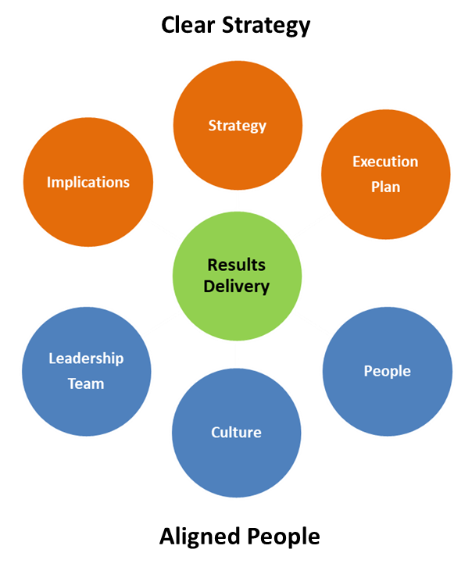
Great Leaders
::
Are trusted
Like people
Like themselves
Are empathetic
Build extraordinary leadership teams
Create more leaders
Enable their people to shine
Embrace stewardship – they strive to leave the business in a better state than they found it.
Combine humility with confidence
Change their minds when a better solution arises or facts change
Share the credit and take the blame
Are authentic / genuine
Deliver results - via a clear strategy and aligned people

Slide 25
Great Leaders
::
Help their people to want to change

Slide 26
Extraordinary Leadership Teams
::
Extraordinary leadership teams are teams of highly effective leaders working together to deliver shared objectives.
Attributes:
Competent in own right
Respect through experience
Respect through attitude and approach
Reputation for delivery
Personal alignment to strategy
Integrity
Customer orientation
Individual
Effectiveness
Effectiveness
as a leader
Attributes:
Leads by example
Sets clear direction
Effective delegation
Listens to understand
Aligns & engages people
Creates more leaders
Stewardship
Empathetic
Authentic
Enables people to succeed
Leadership Team
Effectiveness
Attributes:
Team aligned to clear strategy and success metrics
Inter-departmental interdependencies clear
Collegiate - work together to deliver shared outcomes
Team goals more important than individual goals
Complimentary strengths offsetting others’ weaknesses
Robust but constructive discussion of issues
Creates a culture that enables delivery of the strategy
Foundation:
Mutual trust & respect
Clear accountabilities
Shared objectives
Clear interdependencies
Clear behavioural expectations
Clear decision-making processes
Cabinet responsibility
Cares about team and business

Slide 27
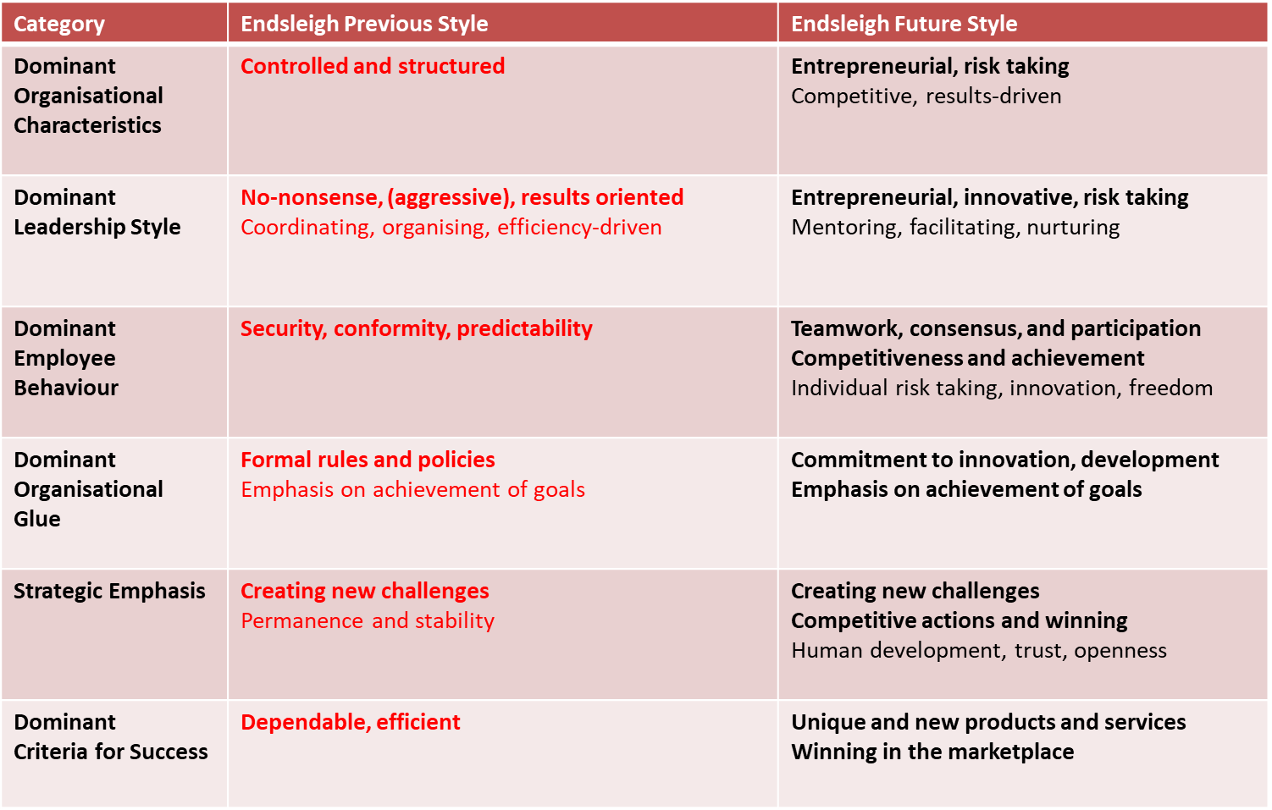
THE COMPETING VALUES FRAMEWORK
Key implications for the SLT ?

